Slide 1
Rational Developer for System z – Foundation Training
Module 1 – Getting Started – Installing and configuring RDz Workstation Client
Jon Sayles, IBM EcoSystems Team

Slide 2
IBM Trademarks and Copyrights
  © Copyright IBM Corporation 2007,2008, 2009. All rights reserved.
  The information contained in these materials is provided for informational purposes only, and is provided AS IS without warranty of any kind, express or implied. IBM shall not be responsible for any damages arising out of the use of, or otherwise related to, these materials. Nothing contained in these materials is intended to, nor shall have the effect of, creating any warranties or representations from IBM or its suppliers or licensors, or altering the terms and conditions of the applicable license agreement governing the use of IBM software. References in these materials to IBM products, programs, or services do not imply that they will be available in all countries in which IBM operates.
  This information is based on current IBM product plans and strategy, which are subject to change by IBM without notice. Product release dates and/or capabilities referenced in these materials may change at any time at IBM’s sole discretion based on market opportunities or other factors, and are not intended to be a commitment to future product or feature availability in any way.
  IBM, the IBM logo, the on-demand business logo, Rational, the Rational logo, and other IBM Rational products and services are trademarks or registered trademarks of the International Business Machines Corporation, in the United States, other countries or both. Other company, product, or service names may be trademarks or service marks of others.

Slide 3

Course Contributing Authors
Thanks to the following individuals, for assisting with this course:
  Bill Klein
  Stephen F. Heffner, President of Pennington Systems Incorporated, Scottsdale, AZ (WWW.Pennington.com)
  Wilbert Kho/IBM
  Curt Bergkvist/Handelsbanken
  Asish Toomuluru/BNSF Railway & Rick Anderson/BNSF Railway

Slide 4
Course Outline
Course Name: Rational Developer for System z Foundation Training
Course Description: Learn how to use Rational Developer for System z to do z/OS traditional development, maintenance, support and for Enterprise Modernization of z/OS applications
Pre-requisites: Some experience developing COBOL applications using z/OS is expected. A working knowledge of SQL is also recommended.
Course Length: ~5days – or if done in self-paced mode, at your own pace
Topics (Agenda)
    Getting Started - installing and configuring RDz - and the course materials, and using Eclipse
    The RDz Workbench
      Code analysis tools
      Editing
      Compiling programs
      Debugging local COBOL programs
    The Data Perspective:
      Working with relational data sources
      Modifying test data
      Editing and testing SQL statements
    Working with remote system resources:
      Connecting to a mainframe
      Data management
      Accessing and editing files
    z/OS Application Development
      Creating MVS Subprojects
      Creating and customizing project properties
    Debugging z/OS Applications
      Debugging Batch Applications
      Setting Debug Tool for Online Applications
    Working with File Manager
      Creating test data
      Editing complex file-types
    Working with mainframe ABENDs using Fault Analyzer
      Creating Fault History views
      Analyzing and solving mainframe ABENDs
    Creating and modifying BMS Maps using the BMS Map Editor

Slide 5
Course Details
Audience
  This course is designed for application developers who have learned or programmed in a 3rd or 4th generation language – and who need to build leading-edge applications using COBOL and Rational Developer for System z.
Prerequisites
  This course assumes that the student has a basic understanding and knowledge of software computing technologies, and general data processing terms, concepts and vocabulary.
  Knowledge of SQL (Structured Query Language) for database access is assumed as well – for certain sections of the course (that will be noted)
  Basic PC and mouse-driven development skills is also assumed
  If you don't have z/OS-mainframe experience there is an optional unit on this

Slide 6

Course Objectives
At the end of this course, you will be able to:
  Create COBOL programs that do batch processing using sequential files (QSAM)
  Understand and use the majority of IBM Enterprise COBOL statements
  Use the development facilities of Rational Developer for System z for:
    Editing
    Compiling
    Debugging
  Understand enough of mainframe JCL to run programs on host systems
  Describe the coding for COBOL programs that:
    Do IMS database (DL/I) and Transaction Manager calls
    Call through CICS command level COBOL
    Read and Write VSAM indexed files
    Access XML
    Can be accessed as Web Services in a Service Oriented Architecture
    Can be accessed via Web 2.0 applications

Slide 7
RDz and Course Setup
UNIT
Topics:
How to take this course
Installing RDz and Setting up for the Course
Install Verification Procedure
Installing the Mainframe resources
About Rational Developer for System z

Slide 8
Topic objectives
After completing this topic, you should be able to:
  Describe how to use these course materials
  Differentiate between the two types of slide topics in the learning modules
  Navigate to additional learning resources for both:
      RDz
      COBOL

Slide 9
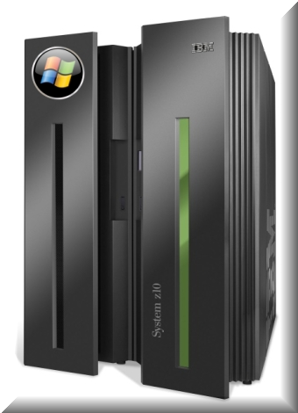
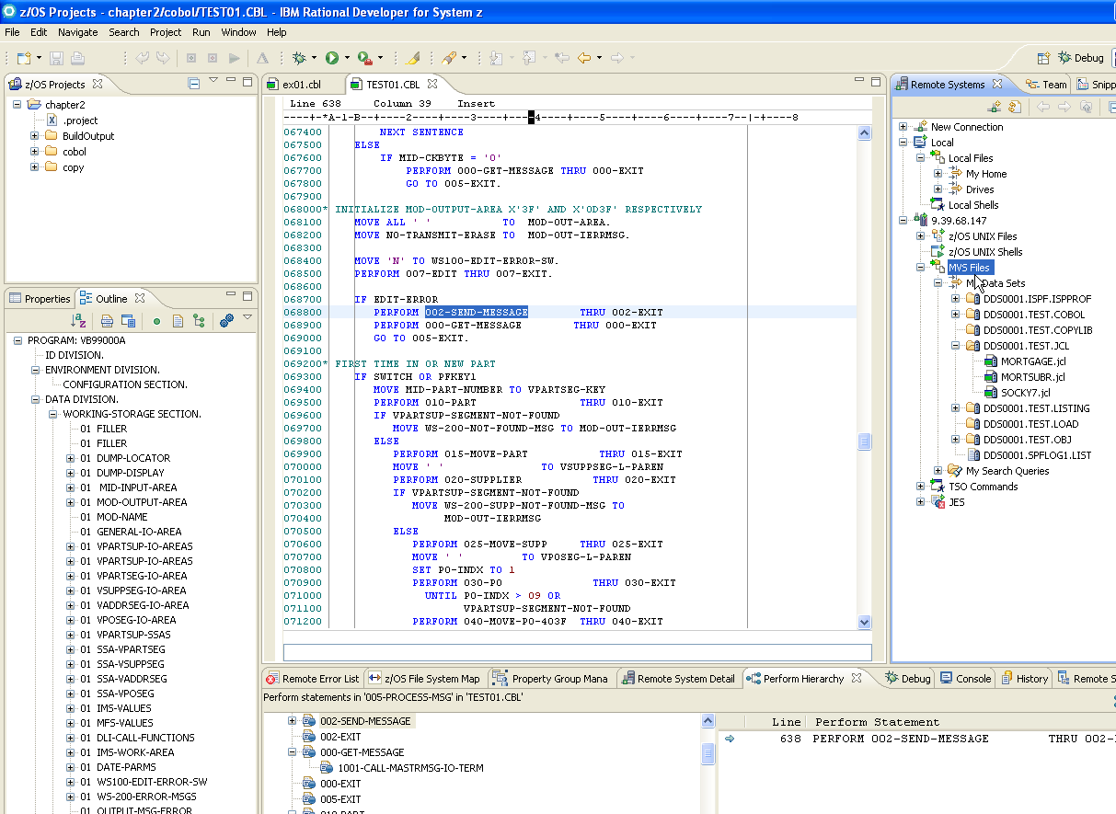
Welcome to Enterprise COBOL and Rational Developer for System z
COBOL runs the worlds' enterprises
RDz is the way we make COBOL development easy
IBM z/10
Rational Developer for System z

Slide 10
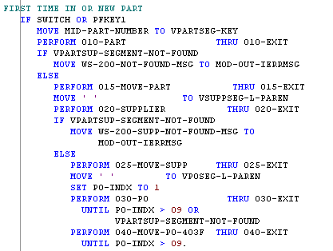

Why COBOL?
Let's look at some numbers…
COBOL applications:
  Process 70% of the world's data
    In finance and insurance over 95%
    60% of all Web-access data resides on a mainframe
  Run over 30,000,000,000 transactions daily
    83% of the transactions worldwide
  Are in production at over 98% of the Fortune 500
    Including the entire Fortune 100
Well over 220,000,000 lines of COBOL running in production world-wide
  > 5,000,000 lines of new COBOL added each year
  All these programs will have to be maintained, supported and enhanced.
There will be a continuing demand for COBOL programmers with about
  70% of the work in the form of maintenance
  30% in the form of enhancements and new development
  New applications – in other languages such as Java – are going to have to co-exist with the existing base of COBOL applications
COBOL

Slide 11
Why RDz?
RDz is IBM's Workbench for developing COBOL in the 2000's
It features a set of high-end, cross-platform graphical tools, that makes as simple as possible:
  Traditional COBOL Development:
    Setting up projects:
      COBOL Batch
      Online projects:
        CICS
        IMS TM
      File and database projects: DB2, QSAM, VSAM, IMS DL/I
    Editing your COBOL source
    Compiling
    Testing - On the mainframe, as well as on your workstation
    Connecting to the mainframe
      Submitting jobs and managing them
    Analyzing and maintaining COBOL applications
    Debugging mainframe ABENDs (defects) and logic errors
  Leading-edge COBOL Development:
    Developing Web and Web 2.0 front-ends to CICS and IMS TM (Transaction Management) applications
    Transforming CICS and IMS applications into Web Services in a Service Oriented Architecture
    Doing XML/COBOL applications
    Working with MQ (Message Queue)
    Connecting to COBOL business applications from Java and .NET applications
    Creating stand-alone Windows applications (.exe files)

Slide 12
How to Use These Course Materials
This course has two different modes of educational delivery – each based on both content matter and effective knowledge transfer:
  Read and Learn: 
  Do and Acquire Skills: 
Notes:
 Notes:

Slide 13
Read and Learn
 Read and learn is the most prevalent form of education presented in this course.
  From the slides you are viewing, you can read and understand concepts about RDz and COBOL. This is static information presented as traditional text and graphics.
  Occasionally a slide will have a double-right-pointed triangle in the header:  This means you should do or try something on your computer.
  The Notes (at the bottom of many slides) present additional information on each concept. The Notes also present (wherever relevant) Java and .NET.
  There are numerous slides that allow you to test your knowledge and learning. These slides contain paper/pencil questions. The answers to most of these questions are at the end of the PowerPoint slides.

Slide 14

How to Use This book
 Do and Acquire
  To make all of the pieces of information covered in this course yours – and to convince you that you’ve got the skills to match the knowledge you accumulate, you will need to use RDz and COBOL to create software functionality.
  There are lots of workshops and labs throughout this course, that will allow you to discover, practice and master the RDz functionality and development techniques used to create no-compromise, production-worthy applications.
  All of the “do this” steps have a consistent icon to the left of them: 
  When you see this  symbol either at the top of a page, or at the beginning of a step, it signifies that you are to “do” something with the product or language.

Slide 15
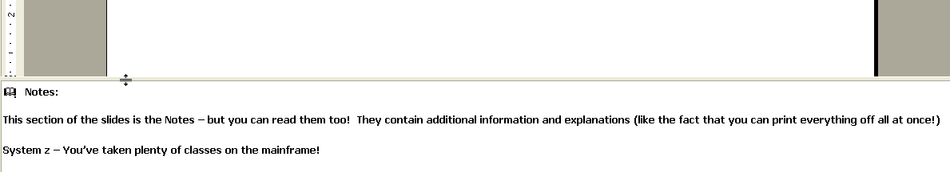
 View the Slide Notes
 Using your mouse, expand the Notes at the bottom of this slide and read them.
Adjust the size of the slides or notes to suit your viewing

Figure 1 – PowerPoint Notes View
Notes:
  Notes:
This section of the slides is the Notes – but you can read them too! They contain additional information and explanations (like the fact that you can print everything off all at once!)
System z – You’ve taken plenty of classes on the mainframe!

Slide 16

 Learn More!
There are a large number of excellent sources for background information
available online. Here are a few we use a lot:
http://www.murach.com/books/mcb2/index.htm - the COBOL reference text book we'll be using for the course. A standard for 1,000,000's of COBOL programmers world-wide
** http://www-949.ibm.com/software/rational/cafe/community/cobol - the official IBM COBOL community site, where you can ask questions, get answers, and learn about all-things-COBOL
** http://publib.boulder.ibm.com/infocenter/zos/basics/index.jsp - an excellent treatise on everything-mainframe
http://www-03.ibm.com/systems/z/destinationz/ - another IBM site for mainframes – more about the hardware, but good quality, free-content
The IBM COBOL “home page” http://www-01.ibm.com/software/awdtools/cobol/
The IBM COBOL for Windows manuals (LRM and PG)
http://publibfp.boulder.ibm.com/epubs/pdf/igy7lr10.pdf
http://publibfp.boulder.ibm.com/epubs/pdf/igy7pg10.pdf
The Enterprise COBOL V4.1 Bookshelf: http://publibfp.boulder.ibm.com/cgi-bin/bookmgr/Shelves/igy3sh40
** Definitely bookmark these sites!
Notes:
 Notes: Depending on your experience, gaining knowledge in leading-edge development subjects and topics can be crucial to the success of your projects. Do not spin your wheels wondering about a given concept, term, new vocab, etc. Look it up!!

Slide 17
RDz Workstation Product and Course Setup
UNIT
Topics:
How to take this course
Installing RDz and Setting up for the Course
Install Verification Procedure
Installing the Mainframe resources
About Rational Developer for System z

Slide 18
Topic objectives
After completing this topic, you should be able to:
  Successfully install and configure RDz
  Successfully install the RDz education example files for this class
  Run the Installation Verification Program – and see running COBOL modules that ensure your setup is successfully complete, and you’re ready to begin learning
 Important Note
  System Requirements for RDz Installation:
    Windows XP or later
    5 gigs of available disk space
    1.5 gigs of RAM

Slide 19

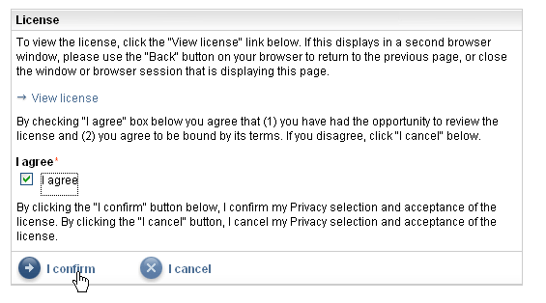
 RDz Installation Process – 1 of 9
RDz can be installed standalone on your PC as follows:
  Open a browser, and point it at:
    http://www.ibm.com/developerworks/downloads/r/rdz/?S_TACT=105AGX23&S_CMP=DLDTA
  Click Free Download Rational Developer for System z
  Click: Web install using IBM's Installation Manager (recommended)
  At the Rational Developer for System z Trial page, you will either have to:
    Login to IBM's DeveloperWorks …or…
    Register for IBM DeveloperWorks then login
    Do so at this point
  When you have logged in, you will see a summary page, where you'll have enter a few additional pieces of information about your interest in RDz, and you'll have to accept the license agreement to continue
  Click I confirm to continue


Slide 20
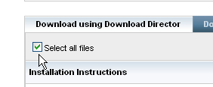
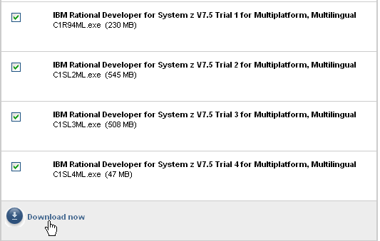
 Installation Process – 2 of 9
From the Downloads page:
- Check: ☑ Select all files
- Scroll to the bottom, and select:
  Download now
This will download about 4+ gigabytes to a directory of your choosing.
  Note: The default directory name is: downloadDirector

Slide 21

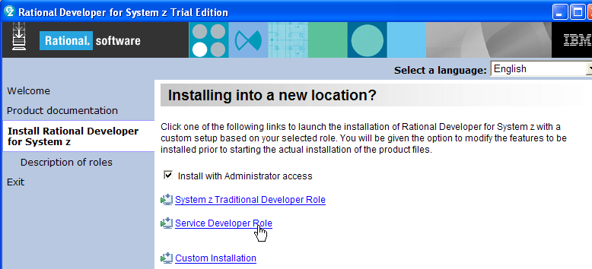
 Installation Process – 3 of 9
Once the download completes
  - Unzip the files into another directory on your PC
When you’ve finished unzipping the files, click:
  - This should be in the RDz76_Trial_Setup folder
This will launch the installation manager. Click Install Rational Developer for System z
 Click: Service Developer Role
See Slide Notes
Notes:
The Service Developer Role option is a superset of the System z Traditional Developer role – and contains all of the System Z Traditional bits + additional functionality for creating Web Services out of CICS and IMS programs

Slide 22
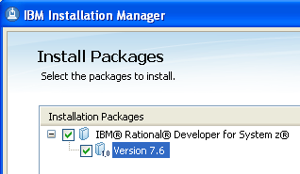
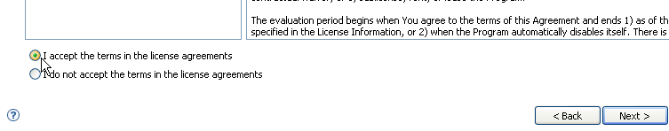
 Installation Process – 4 of 9
The wizard-driven installation process asks you to answer a number of questions about customizing your RDz install
From Install Packages
  Make sure both boxes are checked ➔
  Click Next >
You will be asked to accept the terms of the license agreements
  Do so
  Click Next >

Slide 23
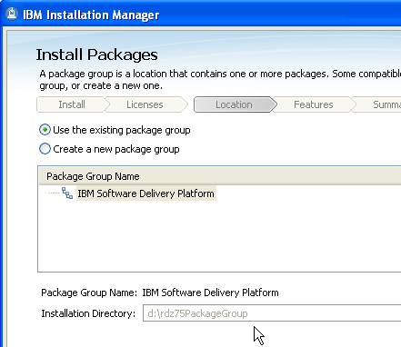
 Installation Process – 5 of 9
You will need to designate two directories for the installed software - "Shared Resources" directory – where other IBM Rational products install into, and a Package Group directory, for the unique files needed for RDz
  We recommend placing the files in separate areas of your hard-drive
Specify (or Browse to) an Installation Directory on your workstation 
Click: Next >

Slide 24
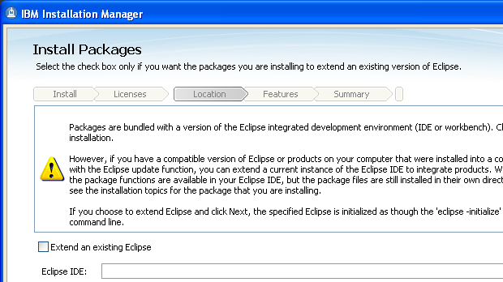
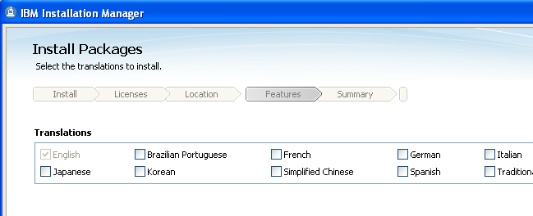
 Installation Process – 6 of 9
Click Next > at the extending Eclipse IDE wizard
  Note – unless you are an experienced Java/Eclipse developer and wish to "shell-share"
Choose your Workbench language
Click Next >

Slide 25
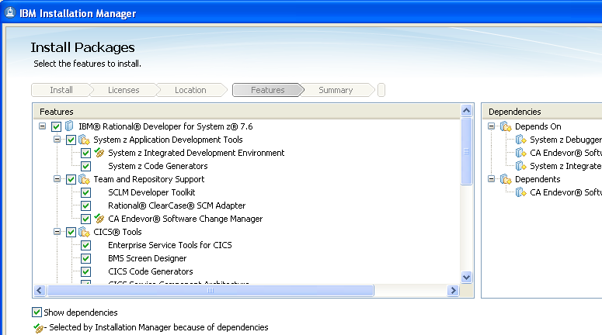
 Installation Process – 7 of 9
We recommend selecting all of these features – in order to learn the curriculum covered in this course
Choose any optional features
Click Next >

Slide 26
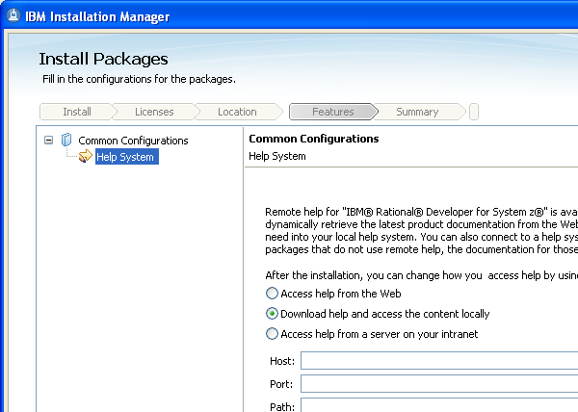
 Installation Process – 8 of 9
You can choose to install the production HELP system
  On your local machine
  Accessed via the web – If you choose this option the "footprint" – product installation size is smaller, but in order to get help on a topic you must be connected to the web.
  Accessed from a corporate server – in which case you must specify the server location
Choose an option
Click Next >

Slide 27
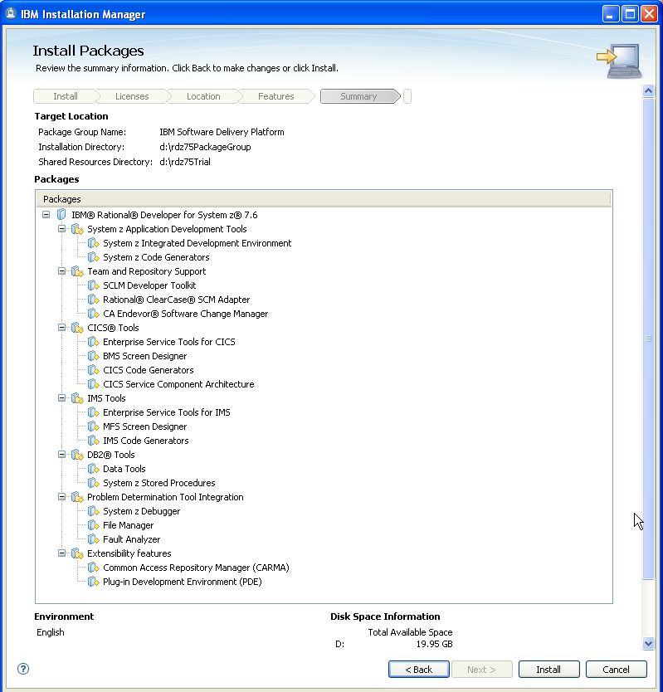

 Installation Process – 9 of 9
At this summary page
Click Install
The install will take up to an hour (depending on your PC's processor and disk read/write speed)
When it's finished close the wizard and verify the installation by starting RDz – and following the steps on the slides in the next section.
Finally, we recommend that make a copy of the launch icon on your desktop

Slide 28
RDz Workstation Product and Course Setup
UNIT
Topics:
How to take this course
Installing RDz and Setting up for the Course
Install Verification Procedure
Installing the Mainframe resources
About Rational Developer for System z
You will create and test your first workstation-based COBOL project - an example project with two simple programs. In order to make sure everything's working you will:
  Create a new, example project
  Build (compile & link) the project
  Run a COBOL program on your desktop

Slide 29
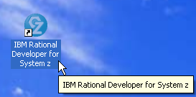
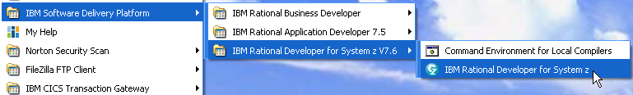
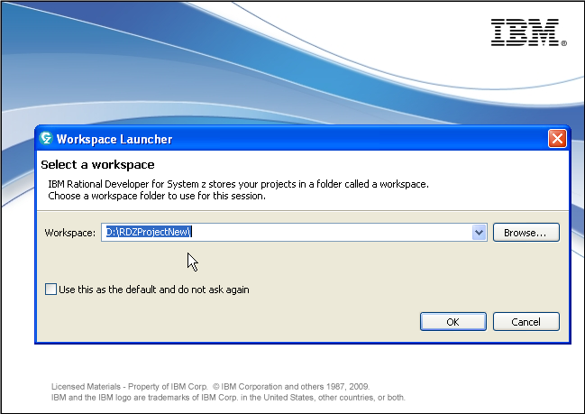
 Install Verification Procedure – 1 of 7
From the Windows start menu, launch RDz
  From the icon on your desktop
  Or from the Start menu
At the Workspace Launcher
  Enter a custom directory for your Workspace and click OK
    Make the directory name easy to remember
    We will explain what a workspace is in the next unit of this course.
    For now assume that a workspace is simply the highest level folder under which all your workstation resources reside

Slide 30
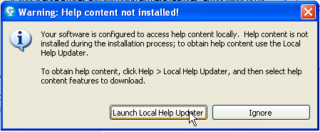
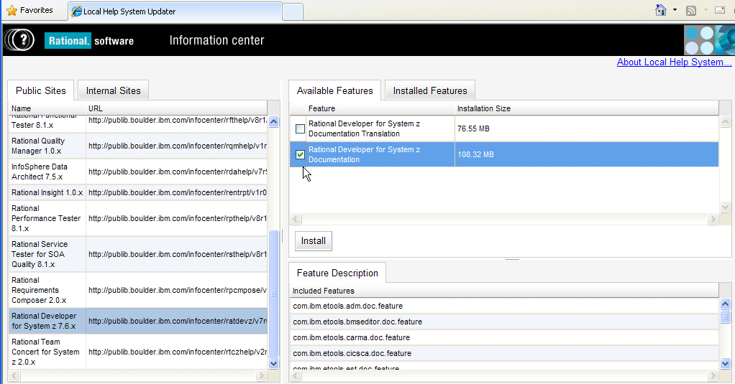
If you see a Warning that Help Was not Installed
Launch: Local Help Updater
Select
  Rational Developer for System z Documentation
Click Install
  Consider running in the background
If you do not see this warning, continue with the tutorial

Slide 31
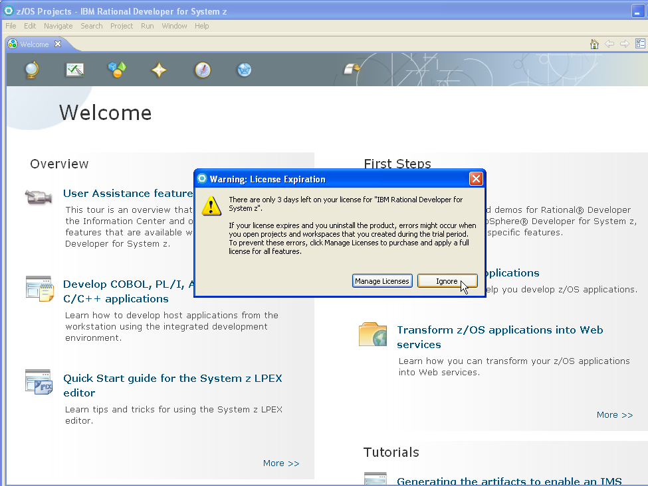
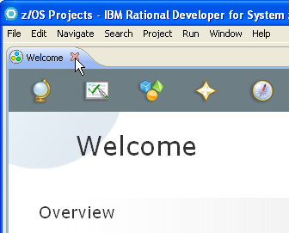
 Install Verification Procedure – 2 of 7
If you are using a trial demo, you will see a License Expiration Warning.
Click Ignore
Close the Welcome tab

Slide 32
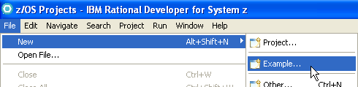
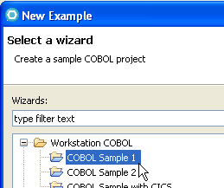
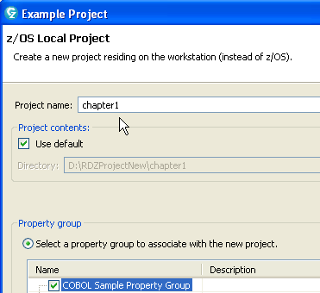
 Installation Verification Procedure – 3 of 7
From the File menu, select:
  New >
  Example…
Expand Workstation COBOL
Select: COBOL Sample 1
Click Next >
Name the project: chapter1
  Be sure a Property Group is selected
Click Finish
See Slide Notes
Notes:
Case Sensitivity:
COBOL is not case-sensitive (at least, not IBM's Enterprise COBOL) – so: field1 – FIELD1 = fiELD1
COBOL program names and project names are not either
But we will establish a naming convention with project names in lower-case

Slide 33
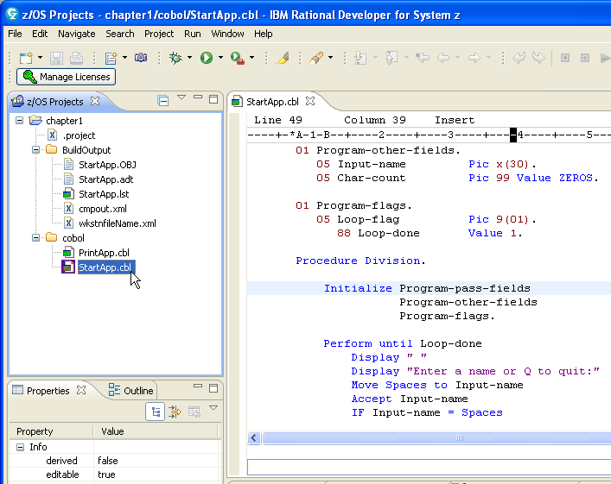
 Installation Verification Procedure – 4 of 7
From z/OS Projects
Double-click StartApp.cbl
  This will load the program source into the editor
Browse the source file – and have your first look at a Windows COBOL example program and the RDz COBOL editor
  Note that we will work primarily with z/OS COBOL in this course
  Don't change any of the source (yet), but you can size the editor window to see more source
 Note that in the next unit we will cover all of the tools and development facilities you're looking at.

Slide 34
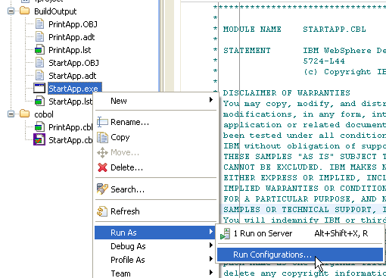

 Installation Verification Procedure – 5 of 7
From z/OS Projects
  Right-Click over the chapter1 project
  From the Context Menu select: Rebuild Project
    This option is near the bottom of the Context Menu
  Expand the BuildOutput folder
  Right-click over StartApp.exe, and select:
    Run As >
    Run Configurations
From Run Configurations
  - Select Compiled Application
  - Click the New launch configuration icon
    Instructions continue on the next slide…

Slide 35
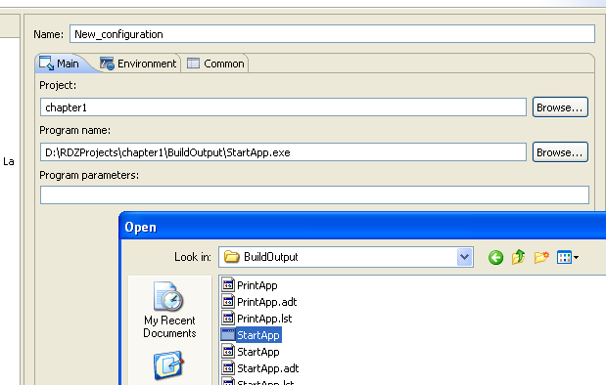
 Installation Verification Procedure – 6 of 7
In the Project area, type: chapter1
In the Program name: area:
  Click Browse…
  Use the Windows dialog to find and select the directory for your Workspace\Project\ BuildOutput folder and StartApp.exe file
    Note that the icon might not show the file suffix – select the run icon as shown
  Click Open
From the Run Configuration window click:
  Apply
  Run

Slide 36
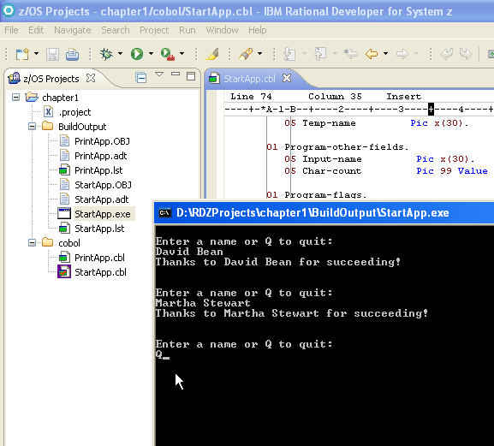
 Installation Verification Procedure – 7 of 7
This will launch a DOS application that prompts you for either a name, or a Q (upper or lower-case) to quit
Enter a few names – after each name, press the Enter key
Enter: Q to quit
 Optional:
Browse through the StartApp and PrintApp program source.
Explore the RDz Help system
View the menus, toolbars, etc.

Slide 37
Installation and Configuration Unit – Summary
After completing the steps in this unit, you should have successfully:
Installed Rational Developer for System z
Configured it on your desktop
Launched the product
Verified the installation by:
  Creating your first local COBOL project
  Compiling the project
  Creating a Run configuration
  Testing the COBOL code

Slide 38
RDz Workstation Product and Course Setup
UNIT
Topics:
How to take this course
Installing RDz and Setting up for the Course
Install Verification Procedure
Installing the Mainframe resources
About Rational Developer for System z

Slide 39
Topic objectives
After completing this topic, you should be able to:
  Successfully setup your mainframe libraries for RDz Distance Learning class
  Copy the correct programs, datasets and files from this PowerPoint slide deck to your libraries in anticipation of the class
  Understand the different workshop alternatives you'll have for RDz class

Slide 40
Connecting to a Mainframe in this class – Plans "A", "B" and "C"
Plan A - If you are learning RDz using your company's mainframe computing center, and if they have successfully installed and configured the RDz mainframe server components:
  Contact your shop's Systems Programmer staff and get the host-name and port#s for connecting to your z/OS machine
  Return in this section to the slides and steps that describe how to create the following resources used in the workshops (see slide titled: Mainframe Resources – 1 of 2)"
    Libraries
    Members in the libraries
    Sequential datasets
  Follow the steps to create the resources you will use in your shop.
  Note that typically only one person will need to do this administrative process
If your shop does not have the RDz mainframe server components installed you, will use either Plan B, or Plan C (and you can skip the rest of these slides and jump to the About Rational Developer for System z section in this PowerPoint)
Plan B - If you are intending to use the IBM Enterprise Modernization Sandbox, now would be a good time to register (obtain a DeveloperWorks sign-on ID) and connect
    You will not need to create a connection per se' but will use one of the built-in connections from the virtual desktops in the Sandbox
    The Sandbox is located: http://www.ibm.com/developerworks/downloads/emsandbox/systemz_applications.html
    You might want to see if you can use this approach
Plan C - If you are intending to access the IBM zServerOS mainframe directly – not through the Sandbox you will have to ensure that:
    You will need access to an IBM mainframe with the URL: zserveros.demos.ibm.com Unfortunately, you can't ping this URL, but you'll find out if you can access it when you attempt to test your connection. The slides to create and test a connection follow.
    You'll also need access to the following Ports from your PC or workstation: 4035, 6715
    If you are working from a home computer, most likely you'll be able to do access zServerOS. But if you are working from an office machine, you should check with your I/T personnel to ensure that you have access to the above remote IP address and the Port#s.

Slide 41
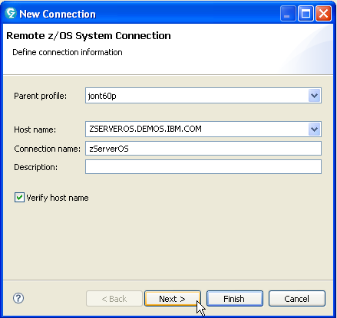
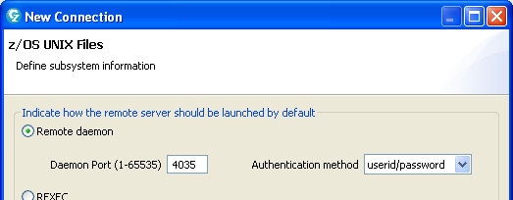
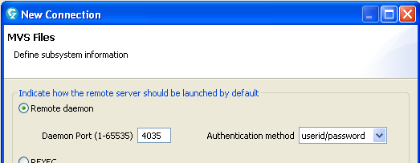
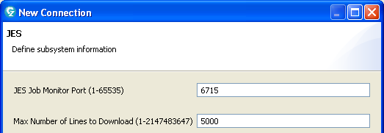
Plan C – Accessing the IBM zServerOS – Screen Captures
Here are the New Connection screen values you can use to create a new zServerOS connection.
  Host name (IP address):
    zserveros.demos.ibm.com
  Ports for z/OS and MVS Files
    4035
  Port for JES
    6715
Note that these are all the wizard defaults

Slide 42
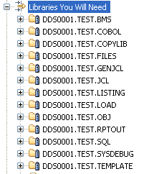
 Mainframe Resources – 1 of 2
1. Allocate the following libraries on your mainframe, with enough space for 8 members:
  LRECL: 80
  DSORG: PO
  RECFM: FB
    <High-Level Qualifier>.TEST.BMS
    <High-Level Qualifier>.TEST.COBOL
    <High-Level Qualifier>.TEST.COPYLIB
    <High-Level Qualifier>.TEST.FILES
    <High-Level Qualifier>.TEST.GENJCL
    <High-Level Qualifier>.TEST.JCL
    <High-Level Qualifier>.TEST.OBJ
    <High-Level Qualifier>.TEST.SQL
    <High-Level Qualifier>.TEST.TEMPLATE
  LRECL: 133
  DSORG: PO
  RECFM: FB
    <High-Level Qualifier>.TEST.RPTOUT
    <High-Level Qualifier>.TEST.LISTING
    <High-Level Qualifier>.TEST.SYSDEBUG
  LRECL: 0
  DSORG: PO
  RECFM: U
    <High-Level Qualifier>.TEST.LOAD
Note: You would only do this workshop, if you are using your company's own mainframe, but want to use the IBM/RDz course lab directions

Slide 43
 Mainframe Resources – 2 of 2
2. Copy source files to PDS Members on your mainframe:
    - This slide's Notes contains eight COBOL programs, two copybooks and two JCL files – separated by blank lines in the Notes area of the slide.
    - For each of the following, please: select, copy/paste and upload the following as PDS members into the associated (your) <HLQ> libraries shown below
      COBOL Programs: Programs with names that start with: HOSP
        ➔ <HLQ>.TEST.COBOL(named the same)
        Note that there are six HOSP* programs in total.
        You can find/identify each from their PROGRAM-ID statement.
      COBOL program: (CUSVSAM) ➔ <HLQ>.TEST.COBOL(CUSVSAM)
      COPYLIB members: (PATREC) ➔ <HLQ>.TEST.COPYLIB(PATREC)
      (POTVSAM) ➔ <HLQ>.TEST.COPYLIB(POTVSAM)
      JCL members: (COMPLINK) ➔ <HLQ>.TEST.JCL(COMPLINK)
      (HOSPRUN) ➔ <HLQ>.TEST.JCL(HOSPRUN)
◉ Note: These files are also available to download from the COBOL Café at: http://www-949.ibm.com/software/rational/cafe/docs/DOC-3129
     Look for an attachment named: mainframe-resources.txt
Notes:
--- HOSP* COBOL programs:
IDENTIFICATION DIVISION.
PROGRAM-ID. HOSPCALC.
AUTHOR. JON SAYLES.
ENVIRONMENT DIVISION.
CONFIGURATION SECTION.
SOURCE-COMPUTER. IBM-390.
OBJECT-COMPUTER. IBM-390.
INPUT-OUTPUT SECTION.
FILE-CONTROL.
SELECT INFILE ASSIGN TO UT-S-INFILE
ORGANIZATION IS SEQUENTIAL
FILE STATUS IS IFCODE.
SELECT RPTFILE ASSIGN TO UT-S-RPTOUT
ORGANIZATION IS SEQUENTIAL
FILE STATUS IS RFCODE.
SELECT OUTFILE ASSIGN TO UT-S-OUTFILE
ORGANIZATION IS SEQUENTIAL
FILE STATUS IS OFCODE.
*3. *** Oooops ERROROUT or ERROUT Which?
SELECT ERRFILE ASSIGN TO UT-S-ERROROUT
ORGANIZATION IS SEQUENTIAL
FILE STATUS IS EFCODE.
DATA DIVISION.
FILE SECTION.
FD INFILE
RECORD CONTAINS 100 CHARACTERS
DATA RECORD IS In-Rec.
01 IN-REC PIC X(100).
FD OUTFILE
RECORD CONTAINS 100 CHARACTERS
DATA RECORD IS OUT-Rec.
01 OUT-REC PIC X(100).
FD ERRFILE
RECORD CONTAINS 100 CHARACTERS
DATA RECORD IS ERR-Rec.
01 ERR-REC PIC X(100).
FD RPTFILE
RECORD CONTAINS 100 CHARACTERS
DATA RECORD IS RPT-Rec.
01 RPT-REC PIC X(100).
WORKING-STORAGE SECTION.
01 FILE-STATUS-CODES.
05 IFCODE PIC X(2).
88 CODE-READ VALUE SPACES.
88 NO-MORE-DATA VALUE "10".
05 OFCODE PIC X(2).
88 CODE-WRITE VALUE SPACES.
05 EFCODE PIC X(2).
88 CODE-WRITE VALUE SPACES.
05 RFCODE PIC X(2).
88 CODE-WRITE VALUE SPACES.
77 INS-COVERAGE-PERC PIC 9(3) VALUE 10.
01 Test-SRCH-ALL.
05 code-value pic x(30)
value "010623547483746439138329484245".
05 codes redefines code-value OCCURS 10 TIMES
INDEXED BY IDX.
10 d-code1 pic 9(1).
10 Rest-Record Pic 9(2).
77 table-max pic s9(3) comp value +100.
77 Diag-code-ws pic s9(4) comp-3 value +0.
01 WS-OUTPUT-REC.
05 PATIENT-NBR-O PIC 9(5).
05 FILLER PIC X(2) VALUE SPACES.
05 PATIENT-NAME-O PIC X(20).
05 PATIENT-PHONE-O PIC X(10).
05 FILLER PIC X(2) VALUE SPACES.
05 PATIENT-TYPE-O PIC X(2).
05 BED-IDENTITY-O PIC ZZZ9.
05 FILLER PIC X(2) VALUE SPACES.
05 CURR-DATE-O PIC X(6).
05 FILLER PIC X(2) VALUE SPACES.
05 PATIENT-AMT-PER-DAY-O PIC $$,$$9.99.
05 FILLER PIC X(2) VALUE SPACES.
05 INS-COVERAGE-PERC-O PIC 999.
05 FILLER PIC X(2) VALUE SPACES.
05 INS-TYPE-O PIC X(4).
05 HOSPITAL-STAY-LTH-O PIC 999.
05 FILLER PIC X(7) VALUE SPACES.
01 WS-TOTALS-REC.
05 FILLER PIC X(8)
VALUE "Rec in: ".
05 READ-OUT PIC Z(4).
05 FILLER PIC X(13)
VALUE " Rec written:".
05 WRITTEN-OUT PIC Z(3).
05 FILLER PIC X(8)
VALUE " Errors:".
05 ERRORS-OUT PIC Z(3).
05 FILLER PIC X(7)
VALUE " Inpat:".
05 INPATIENTS-OUT PIC Z(3).
05 FILLER PIC X(8)
VALUE " Outpat:".
05 OUTPATIENTS-OUT PIC Z(3).
05 FILLER PIC X(5)
VALUE " HMO:".
05 HMO-OUT PIC Z(4).
05 FILLER PIC X(5)
VALUE " S/F:".
05 STATE-FED-OUT PIC Z(3).
05 FILLER PIC X(8)
VALUE " No Cov:".
05 NO-COVERAGE-OUT PIC Z(3).
05 FILLER PIC X(7)
VALUE " GROSS:".
05 TOTAL-GROSS-OUT PIC $,$$$,$99.99.
05 FILLER PIC X(6)
VALUE " NET:".
05 TOTAL-NET-OUT PIC $,$$$,$99.99.
77 WS-DATE PIC 9(6).
77 MORE-RECORDS-SW PIC X(1) VALUE SPACE.
88 NO-MORE-RECORDS VALUE 'N'.
*1. *** Oooops - initialize this field: value +0
77 NBR-MANAGED-CARE PIC S9(4) COMP-3.
*2. *** Oooops ... ... ... ... should be value +100.
77 Divisor PIC S9(3) comp-3 value +00.
01 COUNTERS-AND-ACCUMULATORS.
05 RECORDS-READ PIC S9(4) COMP.
05 RECORDS-WRITTEN PIC S9(4) COMP.
05 ERROR-RECS PIC S9(4) COMP.
05 NBR-INPATIENTS PIC S9(4) COMP.
05 NBR-OUTPATIENTS PIC S9(4) COMP.
05 NBR-HMO PIC S9(4) COMP.
05 NBR-STATE-FED PIC S9(4) COMP.
05 NBR-NO-COVERAGE PIC S9(4) COMP.
05 PAT-TOTAL-AMT-NET PIC S9(7)V99 COMP-3.
05 TOTAL-AMT-GROSS PIC S9(7)V99 COMP-3.
05 TOTAL-AMT-NET PIC S9(7)V99 COMP-3.
01 WS-INPUT-REC.
05 PATIENT-NBR PIC 9(5).
05 PATIENT-NAME.
10 LAST-NAME PIC X(10).
10 FIRST-NAME PIC X(10).
05 PATIENT-PHONE PIC X(10).
05 PATIENT-TYPE PIC X(1).
88 INPATIENT VALUE "I".
88 OUTPATIENT VALUE "0".
88 VALID-TYPE VALUES ARE "I", "O".
05 BED-IDENTITY PIC 9(4).
05 DATE-ADMIT PIC X(10).
05 AMT-PER-DAY PIC 9(5)V99.
05 DIAGNOSTIC-CODE PIC 999.
05 INS-TYPE PIC X(3).
88 VALID-INS-TYPE VALUES ARE "HMO", "PPO", "POS" "MAN".
88 Managed-Care value "MAN".
05 HOSPITAL-STAY-LTH PIC 999.
05 PATIENT-TOT-AMT PIC 9(7)V99.
05 PCP-ID PIC X(6).
05 IN-OUT-NETWORK PIC X(1).
88 IN-NETWORK VALUE "N".
88 OUT-OF-NETWORK VALUE "O".
05 COPAY PIC S9(3).
05 DEDUCTIBLE PIC S9(4).
PROCEDURE DIVISION.
PERFORM 000-HOUSEKEEPING THRU 000-EXIT.
PERFORM 100-MAINLINE THRU 100-EXIT
UNTIL NO-MORE-RECORDS.
PERFORM 200-CLEANUP THRU 200-EXIT.
MOVE ZERO TO RETURN-CODE.
GOBACK.
000-HOUSEKEEPING.
DISPLAY "HOUSEKEEPING".
* Code your statement here to OPEN files
ACCEPT WS-DATE FROM DATE.
OPEN INPUT INFILE.
OPEN OUTPUT OUTFILE, RPTFILE, ERRFILE.
* Code your statement here to read the input file
* Remember to move "NO" to IFCODE if the input file is AT END
READ INFILE INTO WS-INPUT-REC
AT END
MOVE 'N' TO MORE-RECORDS-SW
GO TO 000-EXIT
END-READ
INITIALIZE COUNTERS-AND-ACCUMULATORS,
WS-OUTPUT-REC,
WS-TOTALS-REC
ADD +1 TO RECORDS-READ.
000-EXIT.
EXIT.
100-MAINLINE.
* Validate patient type and insurance coverage
DISPLAY "MAINLINE".
DISPLAY WS-INPUT-REC.
If VALID-TYPE AND VALID-INS-TYPE
WRITE OUT-REC FROM WS-INPUT-REC
ELSE
MOVE WS-INPUT-REC TO ERR-REC
WRITE ERR-REC
ADD +1 TO ERROR-RECS
READ INFILE INTO WS-INPUT-REC
AT END MOVE "N" TO MORE-RECORDS-SW
GO TO 100-EXIT
END-READ
ADD +1 TO RECORDS-READ
GO TO 100-EXIT
END-IF
EVALUATE INS-TYPE
WHEN "HMO" ADD +1 TO NBR-HMO
WHEN "GOV" ADD +1 TO NBR-STATE-FED
WHEN "MAN" ADD +1 TO NBR-MANAGED-CARE
WHEN OTHER ADD +1 TO NBR-NO-COVERAGE
END-EVALUATE
IF INPATIENT
ADD +1 TO NBR-INPATIENTS
ELSE
ADD +1 TO NBR-OUTPATIENTS
END-IF
IF Managed-Care
PERFORM 300-Table-rtn thru 300-Exit
COMPUTE PAT-TOTAL-AMT-NET =
(PATIENT-TOT-AMT +
AMT-PER-DAY * ((100 - INS-COVERAGE-PERC) / Divisor)
- Deductible + COPAY )
END-COMPUTE
Else
COMPUTE PAT-TOTAL-AMT-NET =
(PATIENT-TOT-AMT +
AMT-PER-DAY * ((100 - INS-COVERAGE-PERC) / Divisor))
END-COMPUTE
END-IF
ADD PAT-TOTAL-AMT-NET TO TOTAL-AMT-NET.
ADD PATIENT-TOT-AMT TO TOTAL-AMT-GROSS.
* Move input data to output data
MOVE PATIENT-NBR TO PATIENT-NBR-O.
MOVE PATIENT-NAME TO PATIENT-NAME-O.
MOVE PATIENT-PHONE TO PATIENT-PHONE-O.
MOVE PATIENT-TYPE TO PATIENT-TYPE-O.
MOVE WS-DATE TO CURR-DATE-O.
MOVE BED-IDENTITY TO BED-IDENTITY-O.
ADD PAT-TOTAL-AMT-NET TO PATIENT-TOT-AMT
GIVING PATIENT-AMT-PER-DAY-O.
MOVE INS-COVERAGE-PERC TO INS-COVERAGE-PERC-O.
MOVE INS-TYPE TO INS-TYPE-O.
ADD +1 TO HOSPITAL-STAY-LTH
GIVING HOSPITAL-STAY-LTH-O.
* move in-rec TO out-rec.
WRITE RPT-REC FROM WS-OUTPUT-REC.
ADD +1 TO RECORDS-WRITTEN.
* Code your statements here to read the input file
* Remember to move "NO" to IFCODE if the input file is AT END
READ INFILE INTO WS-INPUT-REC
AT END MOVE "N" TO MORE-RECORDS-SW
GO TO 100-EXIT
END-READ
ADD +1 TO RECORDS-READ.
100-EXIT.
EXIT.
200-CLEANUP.
* Move the final computational fields
DISPLAY "CLEAN-UP".
ADD +1 TO RECORDS-WRITTEN.
MOVE RECORDS-READ TO READ-OUT .
MOVE RECORDS-WRITTEN TO WRITTEN-OUT.
MOVE ERROR-RECS TO ERRORS-OUT.
MOVE NBR-INPATIENTS TO INPATIENTS-OUT.
MOVE NBR-OUTPATIENTS TO OUTPATIENTS-OUT.
MOVE NBR-HMO TO HMO-OUT.
MOVE NBR-STATE-FED TO STATE-FED-OUT.
MOVE NBR-NO-COVERAGE TO NO-COVERAGE-OUT.
MOVE TOTAL-AMT-GROSS TO TOTAL-GROSS-OUT.
MOVE TOTAL-AMT-NET TO TOTAL-NET-OUT.
* Code the statement write the final output record
WRITE RPT-REC FROM WS-TOTALS-REC.
* Code the statement to close all files
CLOSE OUTFILE, RPTFILE, ERRFILE, INFILE.
* Code the statement to Display a successful end-of-job msg
DISPLAY "NORMAL END OF JOB".
200-EXIT.
EXIT.
300-Table-rtn.
*4. *** Oops - Initialize IDX to 1.
SET IDX to table-max.
add d-code1 (IDX) to Diag-code-ws.
300-Exit.
EXIT.
IDENTIFICATION DIVISION.
PROGRAM-ID. HOSPCRFL.
AUTHOR. JON SAYLES.
INSTALLATION. COBOL DEV Center.
DATE-WRITTEN. 01/01/08.
DATE-COMPILED. 01/01/08.
SECURITY. NON-CONFIDENTIAL.
ENVIRONMENT DIVISION.
CONFIGURATION SECTION.
SOURCE-COMPUTER. IBM-390.
OBJECT-COMPUTER. IBM-390.
INPUT-OUTPUT SECTION.
FILE-CONTROL.
SELECT SYSOUT
ASSIGN TO UT-S-SYSOUT.
SELECT OUTFILE
ASSIGN TO UT-S-OUTFILE
FILE STATUS IS OFCODE.
DATA DIVISION.
FILE SECTION.
003400 FD SYSOUT
003500 RECORDING MODE IS F
003600 LABEL RECORDS ARE STANDARD
003700 RECORD CONTAINS 80 CHARACTERS
003800 BLOCK CONTAINS 0 RECORDS
DATA RECORD IS SYSOUT-Rec.
01 SYSOUT-REC PIC X(80).
003400 FD OUTFILE
003500 RECORDING MODE IS F *****************************************************************
IDENTIFICATION DIVISION.
PROGRAM-ID. HOSPIN.
AUTHOR. JON SAYLES.
INSTALLATION. COBOL DEVELOPMENT CENTER.
DATE-WRITTEN. 01/01/08.
DATE-COMPILED. 01/01/08.
SECURITY. NON-CONFIDENTIAL.
*****************************************************************
ENVIRONMENT DIVISION.
CONFIGURATION SECTION.
SOURCE-COMPUTER. IBM-390.
OBJECT-COMPUTER. IBM-390.
INPUT-OUTPUT SECTION.
FILE-CONTROL.
SELECT INFILE ASSIGN TO UT-S-SYSIN
ORGANIZATION IS SEQUENTIAL
FILE STATUS IS IFCODE.
SELECT OUTFILE ASSIGN TO UT-S-RPTOUT
ORGANIZATION IS SEQUENTIAL
FILE STATUS IS OFCODE.
*****************************************************************
DATA DIVISION.
FILE SECTION.
FD INFILE
RECORD CONTAINS 100 CHARACTERS
DATA RECORD IS In-Rec.
01 IN-REC PIC X(100).
FD OUTFILE
RECORD CONTAINS 100 CHARACTERS
DATA RECORD IS OUT-Rec.
01 OUT-REC PIC X(100).
WORKING-STORAGE SECTION.
01 FILE-STATUS-CODES.
05 IFCODE PIC X(2).
88 CODE-READ VALUE SPACES.
88 NO-MORE-DATA VALUE "10".
05 OFCODE PIC X(2).
88 CODE-WRITE VALUE SPACES.
01 WS-INPUT-REC PIC X(100).
01 WS-TEMP.
05 PATIENT-NBR PIC 9(5).
05 PATIENT-NAME.
10 LAST-NAME PIC X(10).
10 FIRST-NAME PIC X(10).
05 PATIENT-PHONE PIC X(10).
05 PATIENT-TYPE PIC X(1).
88 INPATIENT VALUE "I".
88 OUTPATIENT VALUE "0".
88 VALID-TYPE VALUES ARE "I", "O".
05 BED-IDENTITY PIC 9(4).
05 DATE-ADMIT PIC X(10).
05 AMT-PER-DAY PIC 9(5)V99.
05 DIAGNOSTIC-CODE PIC 999.
05 INS-TYPE PIC X(3).
88 VALID-INS-TYPE VALUES ARE "HMO", "PPO", "POS" "MAN".
05 HOSPITAL-STAY-LTH PIC 999.
05 PATIENT-TOT-AMT PIC 9(7)V99.
05 PCP-ID PIC X(6).
05 IN-OUT-NETWORK PIC X(1).
88 IN-NETWORK VALUE "N".
88 OUT-OF-NETWORK VALUE "O".
05 COPAY PIC S9(3).
05 DEDUCTIBLE PIC S9(4).
01 WS-OUTPUT-REC.
05 PATIENT-NBR-O PIC 9(5).
05 FILLER PIC X(2) VALUE SPACES.
05 PATIENT-NAME-O PIC X(20).
05 PATIENT-PHONE-O PIC X(10).
05 FILLER PIC X(2) VALUE SPACES.
05 PATIENT-TYPE-O PIC X(2).
05 BED-IDENTITY-O PIC ZZZ9.
05 FILLER PIC X(2) VALUE SPACES.
05 CURR-DATE-O PIC X(6).
05 FILLER PIC X(2) VALUE SPACES.
05 PATIENT-AMT-PER-DAY-O PIC $$,$$9.99.
05 FILLER PIC X(2) VALUE SPACES.
05 INS-COVERAGE-PERC-O PIC 999.
05 FILLER PIC X(2) VALUE SPACES.
05 INS-TYPE-O PIC X(4).
05 HOSPITAL-STAY-LTH-O PIC 999.
05 FILLER PIC X(7) VALUE SPACES.
01 WS-TOTALS-REC.
05 FILLER PIC X(8)
VALUE "Rec in: ".
05 READ-OUT PIC Z(4).
05 FILLER PIC X(13)
VALUE " Rec written:".
05 WRITTEN-OUT PIC Z(3).
05 FILLER PIC X(8)
VALUE " Errors:".
05 ERRORS-OUT PIC Z(3).
05 FILLER PIC X(7)
VALUE " Inpat:".
05 INPATIENTS-OUT PIC Z(3).
05 FILLER PIC X(8)
VALUE " Outpat:".
05 OUTPATIENTS-OUT PIC Z(3).
05 FILLER PIC X(5)
VALUE " HMO:".
05 HMO-OUT PIC Z(4).
05 FILLER PIC X(5)
VALUE " S/F:".
05 STATE-FED-OUT PIC Z(3).
05 FILLER PIC X(8)
VALUE " No Cov:".
05 NO-COVERAGE-OUT PIC Z(3).
05 FILLER PIC X(7)
VALUE " GROSS:".
05 TOTAL-GROSS-OUT PIC $,$$$,$99.99.
05 FILLER PIC X(6)
VALUE " NET:".
05 TOTAL-NET-OUT PIC $,$$$,$99.99.
77 WS-DATE PIC 9(6).
77 MORE-RECORDS-SW PIC X(1) VALUE SPACE.
88 NO-MORE-RECORDS VALUE 'N'.
01 COUNTERS-AND-ACCUMULATORS.
05 RECORDS-READ PIC S9(4) COMP.
05 RECORDS-WRITTEN PIC S9(4) COMP.
05 ERROR-RECS PIC S9(4) COMP.
05 NBR-INPATIENTS PIC S9(4) COMP.
05 NBR-OUTPATIENTS PIC S9(4) COMP.
05 NBR-HMO PIC S9(4) COMP.
05 NBR-STATE-FED PIC S9(4) COMP.
05 NBR-NO-COVERAGE PIC S9(4) COMP.
05 PAT-TOTAL-AMT-NET PIC S9(7)V99 COMP-3.
05 TOTAL-AMT-GROSS PIC S9(7)V99 COMP-3.
05 TOTAL-AMT-NET PIC S9(7)V99 COMP-3.
******************************************************************
PROCEDURE DIVISION.
PERFORM 000-HOUSEKEEPING THRU 000-EXIT.
PERFORM 100-MAINLINE THRU 100-EXIT
UNTIL NO-MORE-RECORDS.
PERFORM 200-CLEANUP THRU 200-EXIT.
GOBACK.
******************************************************************
* This routine should perform file open and an initial read
******************************************************************
000-HOUSEKEEPING.
DISPLAY "HOUSEKEEPING".
* Code your statement here to OPEN files
ACCEPT WS-DATE FROM DATE.
OPEN INPUT INFILE.
OPEN OUTPUT OUTFILE.
* Code your statement here to read the input file
* Remember to move "NO" to IFCODE if the input file is AT END
READ INFILE INTO WS-INPUT-REC
AT END
MOVE 'N' TO MORE-RECORDS-SW
GO TO 000-EXIT
END-READ
INITIALIZE COUNTERS-AND-ACCUMULATORS,
WS-OUTPUT-REC,
WS-TOTALS-REC
ADD +1 TO RECORDS-READ.
000-EXIT.
EXIT.
******************************************************************
* This routine contains the business logic for the program
******************************************************************
100-MAINLINE.
WRITE OUT-REC FROM WS-INPUT-REC.
* Remember to move "NO" to IFCODE if the input file is AT END
READ INFILE INTO WS-INPUT-REC
AT END MOVE "N" TO MORE-RECORDS-SW
GO TO 100-EXIT
END-READ
ADD +1 TO RECORDS-READ.
100-EXIT.
EXIT.
******************************************************************
* This routine should perform file close operations
******************************************************************
200-CLEANUP.
CLOSE OUTFILE, INFILE.
DISPLAY "NORMAL END OF JOB".
200-EXIT.
EXIT.
003600 LABEL RECORDS ARE STANDARD
003700 RECORD CONTAINS 100 CHARACTERS
003800 BLOCK CONTAINS 0 RECORDS
DATA RECORD IS SYSOUT-Rec.
01 OUT-REC PIC X(100).
WORKING-STORAGE SECTION.
01 FILE-STATUS-CODES.
05 OFCODE PIC X(2).
88 CODE-WRITE VALUE SPACES.
01 WS-OUTPUT-REC PIC X(100).
01 WS-SYSOUT-REC.
05 MSG PIC X(80).
77 WS-DATE PIC 9(6).
01 COUNTERS-AND-ACCUMULATORS.
05 RECORDS-WRITTEN PIC 9(4) value 0.
01 Record-Table.
03 Tab-data.
05 Table-Rec1.
10 filler pic x(50) value
"11111Smith Joanne 2016521111I000112/12/2005".
10 filler pic x(50) value
"0001123010HMO012012345678A1O4H9I0100015".
05 Table-Rec2.
10 filler pic x(50) value
"22222Martin Ricky 2124441212O000210/01/1952".
10 filler pic x(50) value
"0012345623PPO006001231421B2K5T8N0900025".
05 Table-Rec3.
10 filler pic x(50) value
"63333Jones James 2025551212I000311/23/2004".
10 filler pic x(50) value
"0000873547HMO020071232321C3J6F7I0800035".
05 Table-Rec4.
10 filler pic x(50) value
"74444McAllisterBillieJoe 8762341234I023409/23/2008".
10 filler pic x(50) value
"0234323483MAN011045321321D4H7D6I0700045".
05 Table-Rec5.
10 filler pic x(50) value
"55555Luthor Lex 7645234324I098412/31/2008".
10 filler pic x(50) value
"0434356746POS000000123786E5G8S5N0600055".
05 Table-Rec6.
10 filler pic x(50) value
"66666Barnum P.T. 7854354354O078321/09/2006".
10 filler pic x(50) value
"0000432439HMO025070176321F6F9A4N0500065".
05 Table-Rec7.
10 filler pic x(50) value
"98765Clampett E.M. 5464432432I001308/12/2005".
10 filler pic x(50) value
"0002342138POS030004536179G7D0Q6I0400075".
05 Table-Rec8.
10 filler pic x(50) value
"88888Watson Thomas 2127643483O002207/25/2003".
10 filler pic x(50) value
"0012112329PPO010003546321H8S1W3I0300075".
05 Table-Rec9.
10 filler pic x(50) value
"99999Hamilton Alex 9098883213I000206/30/2006".
10 filler pic x(50) value
"0002323483HMO020000047574I9D2E2I0200085".
05 Table-Rec10.
10 filler pic x(50) value
"10021Welch John 2036520980O000105/31/2007".
10 filler pic x(50) value
"0001123010MAN040097812143J0F3F1N0100014".
05 Table-Rec11.
10 filler pic x(50) value
"12901Thomas Frank 2036520980O000105/31/2007".
10 filler pic x(50) value
"0001123010MAN050097812143J0F3F1N ".
05 Table-Rec12.
10 filler pic x(50) value
"88888Bad Pat. Type X ".
10 filler pic x(50) value
" GOV ".
03 recs redefines tab-data OCCURS 12 TIMES
indexed by r-idx.
10 rec-data Pic x(100).
PROCEDURE DIVISION.
PERFORM 000-HOUSEKEEPING THRU 000-EXIT.
PERFORM 100-MAINLINE THRU 100-EXIT 12 times.
PERFORM 200-CLEANUP THRU 200-EXIT.
MOVE +0 TO RETURN-CODE.
GOBACK.
000-HOUSEKEEPING.
MOVE "Starting program: HOSPCRFL" to msg.
* Code your statement here to OPEN files
ACCEPT WS-DATE FROM DATE.
OPEN OUTPUT OUTFILE, SYSOUT.
move spaces to sysout-rec.
Write SYSOUT-REC from WS-SYSOUT-REC.
move ws-date to msg.
write sysout-rec from WS-SYSOUT-REC.
set r-idx to 1.
000-EXIT.
EXIT.
100-MAINLINE.
Move rec-data(r-idx) to WS-OUTPUT-REC.
WRITE OUT-REC FROM WS-OUTPUT-REC.
move ws-output-rec to msg.
write sysout-rec from WS-SYSOUT-REC.
ADD +1 TO RECORDS-WRITTEN.
set r-idx up by 1.
100-EXIT.
EXIT.
200-CLEANUP.
MOVE "Ending program: HOSPCRFL" to msg.
* Code the statement write the final output record
WRITE SYSOUT-REC FROM WS-SYSOUT-REC .
move RECORDS-WRITTEN to MSG.
write sysout-rec from WS-SYSOUT-REC.
* Code the statement to close all files
CLOSE OUTFILE, SYSOUT.
200-EXIT.
EXIT.
*****************************************************************
IDENTIFICATION DIVISION.
PROGRAM-ID. HOSPEDIT.
AUTHOR. JON SAYLES.
INSTALLATION. COBOL DEVELOPMENT CENTER.
DATE-WRITTEN. 01/01/08.
DATE-COMPILED. 01/01/08.
SECURITY. NON-CONFIDENTIAL.
*****************************************************************
* A new comment ...
* Jon's new comment
ENVIRONMENT DIVISION.
CONFIGURATION SECTION.
SOURCE-COMPUTER. IBM-390.
OBJECT-COMPUTER. IBM-390.
INPUT-OUTPUT SECTION.
FILE-CONTROL.
SELECT INFILE ASSIGN TO UT-S-INFILE
ORGANIZATION IS SEQUENTIAL
FILE STATUS IS IFCODE.
SELECT RPTFILE ASSIGN TO UT-S-RPTOUT
ORGANIZATION IS SEQUENTIAL
FILE STATUS IS RFCODE.
SELECT OUTFILE ASSIGN TO UT-S-OUTFILE
ORGANIZATION IS SEQUENTIAL
FILE STATUS IS OFCODE.
SELECT ERRFILE ASSIGN TO UT-S-ERROUT
ORGANIZATION IS SEQUENTIAL
FILE STATUS IS EFCODE.
*****************************************************************
DATA DIVISION.
FILE SECTION.
FD INFILE
RECORD CONTAINS 100 CHARACTERS
DATA RECORD IS In-Rec.
01 IN-REC PIC X(100).
FD OUTFILE
RECORD CONTAINS 100 CHARACTERS
DATA RECORD IS OUT-Rec.
01 OUT-REC PIC X(100).
FD ERRFILE
RECORD CONTAINS 100 CHARACTERS
DATA RECORD IS ERR-Rec.
01 ERR-REC PIC X(100).
FD RPTFILE
RECORD CONTAINS 133 CHARACTERS
DATA RECORD IS RPT-Rec.
01 RPT-REC PIC X(133).
WORKING-STORAGE SECTION.
01 FILE-STATUS-CODES.
05 IFCODE PIC X(2).
88 CODE-READ VALUE SPACES.
88 NO-MORE-DATA VALUE "10".
05 OFCODE PIC X(2).
88 CODE-WRITE VALUE SPACES.
05 EFCODE PIC X(2).
88 CODE-WRITE VALUE SPACES.
05 RFCODE PIC X(2).
88 CODE-WRITE VALUE SPACES.
* COPY PATREC.
01 WS-INPUT-REC.
05 PATIENT-NBR PIC 9(5).
05 PATIENT-NAME.
10 LAST-NAME PIC X(10).
10 FIRST-NAME PIC X(10).
05 PATIENT-PHONE PIC X(10).
05 PATIENT-TYPE PIC X(1).
88 INPATIENT VALUE "I".
88 OUTPATIENT VALUE "0".
88 VALID-TYPE VALUES ARE "I", "O".
05 BED-IDENTITY PIC 9(4).
05 DATE-ADMIT PIC X(10).
05 AMT-PER-DAY PIC 9(5)V99.
05 DIAGNOSTIC-CODE PIC 999.
05 INS-TYPE PIC X(3).
88 VALID-INS-TYPE VALUES ARE "HMO", "PPO", "POS" "MAN".
05 HOSPITAL-STAY-LTH PIC 999.
05 PATIENT-TOT-AMT PIC 9(7)V99.
05 PCP-ID PIC X(6).
05 IN-OUT-NETWORK PIC X(1).
88 IN-NETWORK VALUE "N".
88 OUT-OF-NETWORK VALUE "O".
05 COPAY PIC S9(3).
05 DEDUCTIBLE PIC S9(4).
05 FILLER PIC X(11).
01 TBL.
05 TBL-FIELDS OCCURS 3.
10 VAL-1 PIC X(4).
10 VAL-2 PIC X(4).
10 VAL-3 PIC X(4).
77 INS-COVERAGE-PERC PIC 9(3) VALUE 10.
77 S0CB-VAL PIC 9(3) Value 0.
77 S0C4-VAL PIC S9(3) Value -999.
01 WS-OUTPUT-REC.
05 PATIENT-NBR-O PIC 9(5).
05 FILLER PIC X(2) VALUE SPACES.
05 PATIENT-NAME-O PIC X(20).
05 PATIENT-PHONE-O PIC X(10).
05 FILLER PIC X(2) VALUE SPACES.
05 PATIENT-TYPE-O PIC X(2).
05 BED-IDENTITY-O PIC ZZZ9.
05 FILLER PIC X(2) VALUE SPACES.
05 CURR-DATE-O PIC X(6).
05 FILLER PIC X(2) VALUE SPACES.
05 PATIENT-AMT-PER-DAY-O PIC $$,$$9.99.
05 FILLER PIC X(2) VALUE SPACES.
05 INS-COVERAGE-PERC-O PIC 999.
05 FILLER PIC X(2) VALUE SPACES.
05 INS-TYPE-O PIC X(4).
05 HOSPITAL-STAY-LTH-O PIC 999.
05 FILLER PIC X(7) VALUE SPACES.
01 WS-TOTALS-REC.
05 FILLER PIC X(8)
VALUE "Rec in: ".
05 READ-OUT PIC Z(4).
05 FILLER PIC X(13)
VALUE " Rec written:".
05 WRITTEN-OUT PIC Z(3).
05 FILLER PIC X(8)
VALUE " Errors:".
05 ERRORS-OUT PIC Z(3).
05 FILLER PIC X(7)
VALUE " Inpat:".
05 INPATIENTS-OUT PIC Z(3).
05 FILLER PIC X(8)
VALUE " Outpat:".
05 OUTPATIENTS-OUT PIC Z(3).
05 FILLER PIC X(5)
VALUE " HMO:".
05 HMO-OUT PIC Z(4).
05 FILLER PIC X(5)
VALUE " S/F:".
05 STATE-FED-OUT PIC Z(3).
05 FILLER PIC X(8)
VALUE " No Cov:".
05 NO-COVERAGE-OUT PIC Z(3).
05 FILLER PIC X(7)
VALUE " GROSS:".
05 TOTAL-GROSS-OUT PIC $,$$$,$99.99.
05 FILLER PIC X(6)
VALUE " NET:".
05 TOTAL-NET-OUT PIC $,$$$,$99.99.
01 Field-vals.
05 Field1 PIC X(5) Value "54321".
05 Field2 PIC 9(5) Value 54321.
05 Field3 PIC S9(5) Value 54321.
05 Field4 PIC S9(5) Value -54321.
05 Field5 PIC S9(5) COMP Value 54321.
05 Field6 PIC S9(5) COMP-3 Value 54321.
77 WS-DATE PIC 9(6).
77 MORE-RECORDS-SW PIC X(1) VALUE SPACE.
88 NO-MORE-RECORDS VALUE 'N'.
01 COUNTERS-AND-ACCUMULATORS.
05 RECORDS-READ PIC S9(4) COMP.
05 RECORDS-WRITTEN PIC S9(4) COMP.
05 ERROR-RECS PIC S9(4) COMP.
05 NBR-INPATIENTS PIC S9(4) COMP.
05 NBR-OUTPATIENTS PIC S9(4) COMP.
05 NBR-HMO PIC S9(4) COMP.
05 NBR-STATE-FED PIC S9(4) COMP.
05 NBR-NO-COVERAGE PIC S9(4) COMP.
05 PAT-TOTAL-AMT-NET PIC S9(7)V99 COMP-3.
05 TOTAL-AMT-GROSS PIC S9(7)V99 COMP-3.
05 TOTAL-AMT-NET PIC S9(7)V99 COMP-3.
******************************************************************
PROCEDURE DIVISION.
PERFORM 000-HOUSEKEEPING THRU 000-EXIT.
PERFORM 100-MAINLINE THRU 100-EXIT
UNTIL NO-MORE-RECORDS.
PERFORM 200-CLEANUP THRU 200-EXIT.
GOBACK.
******************************************************************
* This routine should perform file open and an initial read
******************************************************************
000-HOUSEKEEPING.
DISPLAY "HOUSEKEEPING".
* Code your statement here to OPEN files
ACCEPT WS-DATE FROM DATE.
OPEN INPUT INFILE.
OPEN OUTPUT OUTFILE, RPTFILE, ERRFILE.
* Code your statement here to read the input file
* Remember to move "NO" to IFCODE if the input file is AT END
READ INFILE INTO WS-INPUT-REC
AT END
MOVE 'N' TO MORE-RECORDS-SW
GO TO 000-EXIT
END-READ
INITIALIZE COUNTERS-AND-ACCUMULATORS,
WS-OUTPUT-REC,
WS-TOTALS-REC.
ADD +1 TO RECORDS-READ.
MOVE TBL-FIELDS (S0C4-VAL) TO WS-INPUT-REC.
* DIVIDE INS-COVERAGE-PERC by S0CB-VAL
* GIVING INS-COVERAGE-PERC.
000-EXIT.
EXIT.
******************************************************************
* This routine contains the business logic for the program
******************************************************************
100-MAINLINE.
* Validate patient type and insurance coverage
DISPLAY "MAINLINE".
DISPLAY WS-INPUT-REC.
IF VALID-TYPE AND VALID-INS-TYPE
WRITE OUT-REC FROM WS-INPUT-REC
ELSE
MOVE WS-INPUT-REC TO ERR-REC
WRITE ERR-REC
ADD +1 TO ERROR-RECS
READ INFILE INTO WS-INPUT-REC
AT END MOVE "N" TO MORE-RECORDS-SW
GO TO 100-EXIT
END-READ
ADD +1 TO RECORDS-READ
GO TO 100-EXIT
END-IF
* Add to counters and total amounts
EVALUATE INS-TYPE
WHEN "HMO" ADD +1 TO NBR-HMO
WHEN "GOV" ADD +1 TO NBR-STATE-FED
WHEN OTHER ADD +1 TO NBR-NO-COVERAGE
END-EVALUATE
IF INPATIENT
ADD +1 TO NBR-INPATIENTS
ELSE
ADD +1 TO NBR-OUTPATIENTS
END-IF
COMPUTE PAT-TOTAL-AMT-NET =
(PATIENT-TOT-AMT +
AMT-PER-DAY * ((100 - INS-COVERAGE-PERC) / 100))
END-COMPUTE
ADD PAT-TOTAL-AMT-NET TO TOTAL-AMT-NET.
ADD PATIENT-TOT-AMT TO TOTAL-AMT-GROSS.
* Move input data to output data
MOVE PATIENT-NBR TO PATIENT-NBR-O.
MOVE PATIENT-NAME TO PATIENT-NAME-O.
MOVE PATIENT-PHONE TO PATIENT-PHONE-O.
MOVE PATIENT-TYPE TO PATIENT-TYPE-O.
MOVE WS-DATE TO CURR-DATE-O.
MOVE BED-IDENTITY TO BED-IDENTITY-O.
ADD PAT-TOTAL-AMT-NET TO PATIENT-TOT-AMT
GIVING PATIENT-AMT-PER-DAY-O.
MOVE INS-COVERAGE-PERC TO INS-COVERAGE-PERC-O.
MOVE INS-TYPE TO INS-TYPE-O.
ADD +1 TO HOSPITAL-STAY-LTH
GIVING HOSPITAL-STAY-LTH-O.
* move in-rec TO out-rec.
WRITE RPT-REC FROM WS-OUTPUT-REC.
ADD +1 TO RECORDS-WRITTEN.
* Code your statements here to read the input file
* Remember to move "NO" to IFCODE if the input file is AT END
READ INFILE INTO WS-INPUT-REC
AT END MOVE "N" TO MORE-RECORDS-SW
GO TO 100-EXIT
END-READ
ADD +1 TO RECORDS-READ.
100-EXIT.
EXIT.
******************************************************************
* This routine should perform file close operations
******************************************************************
200-CLEANUP.
* Move the final computational fields
DISPLAY "CLEAN-UP".
ADD +1 TO RECORDS-WRITTEN.
MOVE RECORDS-READ TO READ-OUT .
MOVE RECORDS-WRITTEN TO WRITTEN-OUT.
MOVE ERROR-RECS TO ERRORS-OUT.
MOVE NBR-INPATIENTS TO INPATIENTS-OUT.
MOVE NBR-OUTPATIENTS TO OUTPATIENTS-OUT.
MOVE NBR-HMO TO HMO-OUT.
MOVE NBR-STATE-FED TO STATE-FED-OUT.
MOVE NBR-NO-COVERAGE TO NO-COVERAGE-OUT.
MOVE TOTAL-AMT-GROSS TO TOTAL-GROSS-OUT.
MOVE TOTAL-AMT-NET TO TOTAL-NET-OUT.
* Code the statement write the final output record
WRITE RPT-REC FROM WS-TOTALS-REC.
* Code the statement to close all files
CLOSE OUTFILE, RPTFILE, ERRFILE, INFILE.
* Code the statement to Display a successful end-of-job message
DISPLAY "NORMAL END OF JOB".
200-EXIT.
EXIT.
*****************************************************************
IDENTIFICATION DIVISION.
PROGRAM-ID. HOSPIN.
AUTHOR. JON SAYLES.
INSTALLATION. COBOL DEVELOPMENT CENTER.
DATE-WRITTEN. 01/01/08.
DATE-COMPILED. 01/01/08.
SECURITY. NON-CONFIDENTIAL.
*****************************************************************
ENVIRONMENT DIVISION.
CONFIGURATION SECTION.
SOURCE-COMPUTER. IBM-390.
OBJECT-COMPUTER. IBM-390.
INPUT-OUTPUT SECTION.
FILE-CONTROL.
SELECT INFILE ASSIGN TO UT-S-SYSIN
ORGANIZATION IS SEQUENTIAL
FILE STATUS IS IFCODE.
SELECT OUTFILE ASSIGN TO UT-S-RPTOUT
ORGANIZATION IS SEQUENTIAL
FILE STATUS IS OFCODE.
*****************************************************************
DATA DIVISION.
FILE SECTION.
FD INFILE
RECORD CONTAINS 100 CHARACTERS
DATA RECORD IS In-Rec.
01 IN-REC PIC X(100).
FD OUTFILE
RECORD CONTAINS 100 CHARACTERS
DATA RECORD IS OUT-Rec.
01 OUT-REC PIC X(100).
WORKING-STORAGE SECTION.
01 FILE-STATUS-CODES.
05 IFCODE PIC X(2).
88 CODE-READ VALUE SPACES.
88 NO-MORE-DATA VALUE "10".
05 OFCODE PIC X(2).
88 CODE-WRITE VALUE SPACES.
01 WS-INPUT-REC PIC X(100).
01 WS-TEMP.
05 PATIENT-NBR PIC 9(5).
05 PATIENT-NAME.
10 LAST-NAME PIC X(10).
10 FIRST-NAME PIC X(10).
05 PATIENT-PHONE PIC X(10).
05 PATIENT-TYPE PIC X(1).
88 INPATIENT VALUE "I".
88 OUTPATIENT VALUE "0".
88 VALID-TYPE VALUES ARE "I", "O".
05 BED-IDENTITY PIC 9(4).
05 DATE-ADMIT PIC X(10).
05 AMT-PER-DAY PIC 9(5)V99.
05 DIAGNOSTIC-CODE PIC 999.
05 INS-TYPE PIC X(3).
88 VALID-INS-TYPE VALUES ARE "HMO", "PPO", "POS" "MAN".
05 HOSPITAL-STAY-LTH PIC 999.
05 PATIENT-TOT-AMT PIC 9(7)V99.
05 PCP-ID PIC X(6).
05 IN-OUT-NETWORK PIC X(1).
88 IN-NETWORK VALUE "N".
88 OUT-OF-NETWORK VALUE "O".
05 COPAY PIC S9(3).
05 DEDUCTIBLE PIC S9(4).
01 WS-OUTPUT-REC.
05 PATIENT-NBR-O PIC 9(5).
05 FILLER PIC X(2) VALUE SPACES.
05 PATIENT-NAME-O PIC X(20).
05 PATIENT-PHONE-O PIC X(10).
05 FILLER PIC X(2) VALUE SPACES.
05 PATIENT-TYPE-O PIC X(2).
05 BED-IDENTITY-O PIC ZZZ9.
05 FILLER PIC X(2) VALUE SPACES.
05 CURR-DATE-O PIC X(6).
05 FILLER PIC X(2) VALUE SPACES.
05 PATIENT-AMT-PER-DAY-O PIC $$,$$9.99.
05 FILLER PIC X(2) VALUE SPACES.
05 INS-COVERAGE-PERC-O PIC 999.
05 FILLER PIC X(2) VALUE SPACES.
05 INS-TYPE-O PIC X(4).
05 HOSPITAL-STAY-LTH-O PIC 999.
05 FILLER PIC X(7) VALUE SPACES.
01 WS-TOTALS-REC.
05 FILLER PIC X(8)
VALUE "Rec in: ".
05 READ-OUT PIC Z(4).
05 FILLER PIC X(13)
VALUE " Rec written:".
05 WRITTEN-OUT PIC Z(3).
05 FILLER PIC X(8)
VALUE " Errors:".
05 ERRORS-OUT PIC Z(3).
05 FILLER PIC X(7)
VALUE " Inpat:".
05 INPATIENTS-OUT PIC Z(3).
05 FILLER PIC X(8)
VALUE " Outpat:".
05 OUTPATIENTS-OUT PIC Z(3).
05 FILLER PIC X(5)
VALUE " HMO:".
05 HMO-OUT PIC Z(4).
05 FILLER PIC X(5)
VALUE " S/F:".
05 STATE-FED-OUT PIC Z(3).
05 FILLER PIC X(8)
VALUE " No Cov:".
05 NO-COVERAGE-OUT PIC Z(3).
05 FILLER PIC X(7)
VALUE " GROSS:".
05 TOTAL-GROSS-OUT PIC $,$$$,$99.99.
05 FILLER PIC X(6)
VALUE " NET:".
05 TOTAL-NET-OUT PIC $,$$$,$99.99.
77 WS-DATE PIC 9(6).
77 MORE-RECORDS-SW PIC X(1) VALUE SPACE.
88 NO-MORE-RECORDS VALUE 'N'.
01 COUNTERS-AND-ACCUMULATORS.
05 RECORDS-READ PIC S9(4) COMP.
05 RECORDS-WRITTEN PIC S9(4) COMP.
05 ERROR-RECS PIC S9(4) COMP.
05 NBR-INPATIENTS PIC S9(4) COMP.
05 NBR-OUTPATIENTS PIC S9(4) COMP.
05 NBR-HMO PIC S9(4) COMP.
05 NBR-STATE-FED PIC S9(4) COMP.
05 NBR-NO-COVERAGE PIC S9(4) COMP.
05 PAT-TOTAL-AMT-NET PIC S9(7)V99 COMP-3.
05 TOTAL-AMT-GROSS PIC S9(7)V99 COMP-3.
05 TOTAL-AMT-NET PIC S9(7)V99 COMP-3.
******************************************************************
PROCEDURE DIVISION.
PERFORM 000-HOUSEKEEPING THRU 000-EXIT.
PERFORM 100-MAINLINE THRU 100-EXIT
UNTIL NO-MORE-RECORDS.
PERFORM 200-CLEANUP THRU 200-EXIT.
GOBACK.
******************************************************************
* This routine should perform file open and an initial read
******************************************************************
000-HOUSEKEEPING.
DISPLAY "HOUSEKEEPING".
* Code your statement here to OPEN files
ACCEPT WS-DATE FROM DATE.
OPEN INPUT INFILE.
OPEN OUTPUT OUTFILE.
* Code your statement here to read the input file
* Remember to move "NO" to IFCODE if the input file is AT END
READ INFILE INTO WS-INPUT-REC
AT END
MOVE 'N' TO MORE-RECORDS-SW
GO TO 000-EXIT
END-READ
INITIALIZE COUNTERS-AND-ACCUMULATORS,
WS-OUTPUT-REC,
WS-TOTALS-REC
ADD +1 TO RECORDS-READ.
000-EXIT.
EXIT.
******************************************************************
* This routine contains the business logic for the program
******************************************************************
100-MAINLINE.
WRITE OUT-REC FROM WS-INPUT-REC.
* Remember to move "NO" to IFCODE if the input file is AT END
READ INFILE INTO WS-INPUT-REC
AT END MOVE "N" TO MORE-RECORDS-SW
GO TO 100-EXIT
END-READ
ADD +1 TO RECORDS-READ.
100-EXIT.
EXIT.
******************************************************************
* This routine should perform file close operations
******************************************************************
200-CLEANUP.
CLOSE OUTFILE, INFILE.
DISPLAY "NORMAL END OF JOB".
200-EXIT.
EXIT.
*****************************************************************
IDENTIFICATION DIVISION.
PROGRAM-ID. HOSPSORT.
AUTHOR. JON SAYLES.
INSTALLATION. COBOL DEVELOPMENT CENTER.
DATE-WRITTEN. 01/01/08.
DATE-COMPILED. 01/01/08.
SECURITY. NON-CONFIDENTIAL.
*****************************************************************
***************My new code***************************************
ENVIRONMENT DIVISION.
CONFIGURATION SECTION.
SOURCE-COMPUTER. IBM-390.
OBJECT-COMPUTER. IBM-390.
INPUT-OUTPUT SECTION.
FILE-CONTROL.
SELECT INFILE ASSIGN TO UT-S-INFILE
ORGANIZATION IS SEQUENTIAL
FILE STATUS IS IFCODE.
SELECT OUTFILE ASSIGN TO UT-S-OUTFILE
ORGANIZATION IS SEQUENTIAL
FILE STATUS IS OFCODE.
SELECT SRTFILE ASSIGN TO UT-S-SORTWRK.
*****************************************************************
DATA DIVISION.
FILE SECTION.
FD INFILE
RECORD CONTAINS 100 CHARACTERS
DATA RECORD IS In-Rec.
01 IN-REC PIC X(100).
FD OUTFILE
RECORD CONTAINS 100 CHARACTERS
DATA RECORD IS OUT-Rec.
01 OUT-REC PIC X(100).
SD SRTFILE
RECORD CONTAINS 100 CHARACTERS
DATA RECORD IS SRT-Rec.
01 SRT-REC.
05 SRT-KEY PIC X(5).
05 FILLER PIC X(95).
WORKING-STORAGE SECTION.
01 FILE-STATUS-CODES.
05 IFCODE PIC X(2).
88 CODE-READ VALUE SPACES.
88 NO-MORE-DATA VALUE "10".
05 OFCODE PIC X(2).
88 CODE-WRITE VALUE SPACES.
05 EFCODE PIC X(2).
88 CODE-WRITE VALUE SPACES.
05 RFCODE PIC X(2).
88 CODE-WRITE VALUE SPACES.
******************************************************************
PROCEDURE DIVISION.
SORT SRTFILE ON ASCENDING SRT-KEY
USING INFILE
GIVING OUTFILE.
GOBACK.
*****************************************************************
IDENTIFICATION DIVISION.
PROGRAM-ID. HOSPSRCH.
AUTHOR. JON SAYLES.
INSTALLATION. COBOL DEVELOPMENT CENTER.
DATE-WRITTEN. 01/01/08.
DATE-COMPILED. 01/01/08.
SECURITY. NON-CONFIDENTIAL.
*****************************************************************
ENVIRONMENT DIVISION.
CONFIGURATION SECTION.
SOURCE-COMPUTER. IBM-390.
OBJECT-COMPUTER. IBM-390.
INPUT-OUTPUT SECTION.
FILE-CONTROL.
SELECT INFILE ASSIGN TO UT-S-INFILE
ORGANIZATION IS SEQUENTIAL
FILE STATUS IS IFCODE.
SELECT OUTFILE ASSIGN TO UT-S-OUTFILE
ORGANIZATION IS SEQUENTIAL
FILE STATUS IS OFCODE.
SELECT ERRFILE ASSIGN TO UT-S-ERROUT
ORGANIZATION IS SEQUENTIAL
FILE STATUS IS EFCODE.
*****************************************************************
DATA DIVISION.
FILE SECTION.
FD INFILE
RECORD CONTAINS 100 CHARACTERS
DATA RECORD IS In-Rec.
01 IN-REC PIC X(100).
FD OUTFILE
RECORD CONTAINS 100 CHARACTERS
DATA RECORD IS OUT-REC.
01 OUT-REC PIC X(100).
FD ERRFILE
RECORD CONTAINS 100 CHARACTERS
DATA RECORD IS ERR-REC.
01 ERR-REC PIC X(100).
WORKING-STORAGE SECTION.
01 FILE-STATUS-CODES.
05 IFCODE PIC X(2).
88 CODE-READ VALUE SPACES.
88 NO-MORE-DATA VALUE "10".
05 OFCODE PIC X(2).
88 CODE-WRITE VALUE SPACES.
05 EFCODE PIC X(2).
88 CODE-WRITE VALUE SPACES.
05 RFCODE PIC X(2).
88 CODE-WRITE VALUE SPACES.
01 WS-INPUT-REC.
05 PATIENT-NBR PIC 9(5).
05 PATIENT-NAME.
10 LAST-NAME PIC X(10).
10 FIRST-NAME PIC X(10).
05 PATIENT-PHONE PIC X(10).
05 PATIENT-TYPE PIC X(1).
88 INPATIENT VALUE "I".
88 OUTPATIENT VALUE "0".
88 VALID-TYPE VALUES ARE "I", "O".
05 BED-IDENTITY PIC 9(4).
05 DATE-ADMIT PIC X(10).
05 AMT-PER-DAY PIC 9(5)V99.
05 DIAGNOSTIC-CODE PIC 999.
05 INS-TYPE PIC X(3).
88 VALID-INS-TYPE VALUES ARE "HMO", "PPO", "POS" "MAN".
05 HOSPITAL-STAY-LTH PIC 999.
05 PATIENT-TOT-AMT PIC 9(7)V99.
05 PCP-ID PIC X(6).
05 IN-OUT-NETWORK PIC X(1).
88 IN-NETWORK VALUE "N".
88 OUT-OF-NETWORK VALUE "O".
05 COPAY PIC S9(3).
05 DEDUCTIBLE PIC S9(4).
77 INS-COVERAGE-PERC PIC 9(3) VALUE 10.
******************************************************************
* DCLGEN TABLE(ENGLAND.FRIENDZ)
* LIBRARY(ENGLAND.COBOL.COPYLIB(RDZDCLS))
* LANGUAGE(COBOL)
* STRUCTURE(FRIENDZRECORD)
* APOST
* ... IS THE DCLGEN COMMAND THAT MADE THE FOLLOWING STATEMENTS
******************************************************************
EXEC SQL DECLARE DDS0001.DIAG_CODES TABLE
( DIAG_CODE CHAR(3) NOT NULL,
INS_TYPE CHAR(3) NOT NULL,
COPAY SMALLINT NOT NULL,
DEDUCTIBLE SMALLINT NOT NULL
) END-EXEC.
******************************************************************
* COBOL DECLARATION FOR TABLE ENGLAND.FRIENDZ
******************************************************************
01 DIAG-CODES.
10 DIAG-CODE PIC X(03).
10 INS-TYPE PIC X(03).
10 COPAY PIC S9(4) COMP.
10 DEDUCTIBLE PIC S9(4) COMP.
******************************************************************
* THE NUMBER OF COLUMNS DESCRIBED BY THIS DECLARATION IS 4
******************************************************************
01 Diagnostic-code-table.
05 code-value-1 pic x(30)
value "010623547483746439138329484245".
05 codes redefines code-value-1 OCCURS 10 TIMES
INDEXED BY D-IDX.
10 d-code pic 9(3).
77 WS-DATE PIC 9(6).
77 MORE-RECORDS-SW PIC X(1) VALUE SPACE.
88 NO-MORE-RECORDS VALUE 'N'.
01 COUNTERS-AND-ACCUMULATORS.
05 RECORDS-READ PIC S9(4) COMP.
05 RECORDS-WRITTEN PIC S9(4) COMP.
05 ERROR-RECS PIC S9(4) COMP.
05 NBR-INPATIENTS PIC S9(4) COMP.
05 NBR-OUTPATIENTS PIC S9(4) COMP.
05 NBR-HMO PIC S9(4) COMP.
05 NBR-STATE-FED PIC S9(4) COMP.
05 NBR-NO-COVERAGE PIC S9(4) COMP.
05 PAT-TOTAL-AMT-NET PIC S9(7)V99 COMP-3.
05 TOTAL-AMT-GROSS PIC S9(7)V99 COMP-3.
05 TOTAL-AMT-NET PIC S9(7)V99 COMP-3.
******************************************************************
PROCEDURE DIVISION.
PERFORM 000-HOUSEKEEPING THRU 000-EXIT.
PERFORM 100-MAINLINE THRU 100-EXIT
UNTIL NO-MORE-RECORDS.
PERFORM 200-CLEANUP THRU 200-EXIT.
GOBACK.
******************************************************************
* This routine should perform file open and an initial read
******************************************************************
000-HOUSEKEEPING.
DISPLAY "HOUSEKEEPING".
* Code your statement here to OPEN files
ACCEPT WS-DATE FROM DATE.
OPEN INPUT INFILE,
OUTPUT OUTFILE, ERRFILE.
* Remember to move "NO" to IFCODE if the input file is AT END
READ INFILE INTO WS-INPUT-REC
AT END
MOVE 'N' TO MORE-RECORDS-SW
GO TO 000-EXIT
END-READ
INITIALIZE COUNTERS-AND-ACCUMULATORS.
ADD +1 TO RECORDS-READ.
000-EXIT.
EXIT.
******************************************************************
* This routine contains the business logic for the program
******************************************************************
100-MAINLINE.
* Validate patient type and insurance coverage
* DISPLAY "MAINLINE".
* DISPLAY WS-INPUT-REC.
SET D-IDX TO 1.
SEARCH CODES
AT END
WRITE ERR-REC FROM WS-INPUT-REC
ADD +1 TO ERROR-RECS
READ INFILE INTO WS-INPUT-REC
AT END MOVE "N" TO MORE-RECORDS-SW
GO TO 100-EXIT
END-READ
ADD +1 TO RECORDS-READ
GO TO 100-EXIT
WHEN Diagnostic-code = CODES(D-IDX)
COMPUTE PATIENT-TOT-AMT =
PATIENT-TOT-AMT * 1.05
WRITE OUT-REC FROM WS-INPUT-REC
END-Search
* Add to counters and total amount.
* Code your statements here to read the input file
* Remember to move "NO" to IFCODE if the input file is AT END
READ INFILE INTO WS-INPUT-REC
AT END MOVE "N" TO MORE-RECORDS-SW
GO TO 100-EXIT
END-READ
ADD +1 TO RECORDS-READ.
100-EXIT.
EXIT.
******************************************************************
* This routine should perform file close operations
******************************************************************
200-CLEANUP.
* Move the final computational fields
DISPLAY "CLEAN-UP".
ADD +1 TO RECORDS-WRITTEN.
* Code the statement write the final output record
* Code the statement to close all files
CLOSE OUTFILE, ERRFILE, INFILE.
* Code the statement to Display a successful end-of-job message
DISPLAY "NORMAL END OF JOB".
200-EXIT.
EXIT.
IDENTIFICATION DIVISION.
PROGRAM-ID. CUSVSAM.
AUTHOR. R. Barosa.
ENVIRONMENT DIVISION.
INPUT-OUTPUT SECTION.
FILE-CONTROL.
SELECT POTVSAM-FILE
ASSIGN to POTVSAM
ORGANIZATION is INDEXED
ACCESS MODE is RANDOM
RECORD KEY is CUST-NO
FILE STATUS is POTVSAM-STATUS.
DATA DIVISION.
FILE SECTION.
FD POTVSAM-FILE.
COPY POTVSAM.
WORKING-STORAGE SECTION.
* --------------------------------------------------------------- -----
01 WS-PROGRAM PIC X(08) VALUE 'CUSVSAM'.
01 WS-LITERAL-WS PIC X(48) VALUE
' WORKING STORAGE STARTS HERE'.
01 W-POTVSAM-RECORD.
03 W-CUST-NO PIC 999.
03 W-CUST-LN PIC X(25).
03 W-CUST-FN PIC X(15).
03 W-CUST-ADDR1 PIC X(20).
03 W-CUST-CITY PIC X(20).
03 W-CUST-ST PIC X(5).
03 W-CUST-CTRY PIC X(15).
01 POTVSAM-STATUS PIC XX.
01 WORK-FIELDS.
03 INPUT-NAME Pic x(30).
03 PROGRAM-TO-CALL PIC X(07).
03 RECEIVED-FROM-CALLED PIC 99.
03 VALUE1 PIC 99.
03 FIELD-A PIC X(6).
03 FIELD-B PIC X(6).
03 FIELD-C PIC X(6).
03 WHICH-LAB PIC X(4).
03 RESULT PIC 99.
03 BRANCHFLAG PIC 99.
* ==========================POTVSAM-==============================
PROCEDURE DIVISION.
DISPLAY "Program CUSVSAM starting.RS. "
OPEN INPUT POTVSAM-FILE
IF POTVSAM-STATUS = '00'
CONTINUE
ELSE
DISPLAY 'POTVSAM: FAILURE-OPEN-!!!'
GOBACK.
MOVE 1 to W-CUST-NO.
PERFORM 0100-POTVSAM-READ THRU
0100-EXIT UNTIL W-CUST-NO = 010.
CLOSE POTVSAM-FILE.
GO TO 0150-SECOND-PART.
0100-POTVSAM-READ.
* MOVE W-CUST-NO
READ POTVSAM-FILE INTO W-POTVSAM-RECORD KEY IS CUST-NO
INVALID KEY
DISPLAY 'KEY ' CUST-NO 'ERROR READING VSAM FILE'
GOBACK.
DISPLAY 'CUST NO: ' W-CUST-NO ' ' W-CUST-FN W-CUST-LN
W-CUST-ADDR1 W-CUST-CITY W-CUST-CTRY
ADD 1 TO W-CUST-NO.
0100-EXIT.
EXIT.
* --------------------------------------------------------------------
0150-SECOND-PART.
MOVE 2 TO BRANCHFLAG.
MOVE 'AAAAAA' to FIELD-A.
MOVE 'BBBBBB' to FIELD-B.
MOVE 'CCCCCC' to FIELD-C.
MOVE "LAB2" to WHICH-LAB.
0200-LOGIC.
IF WHICH-LAB = 'LAB2'
* If is LAB2 lets do a dynamic CALL.. and force a divide by ZERO
MOVE "REGI0B" TO PROGRAM-TO-CALL
CALL PROGRAM-TO-CALL USING RECEIVED-FROM-CALLED
MOVE 66 TO VALUE1
DIVIDE VALUE1 BY RECEIVED-FROM-CALLED GIVING RESULT
DISPLAY "The result is ... " RESULT
END-IF
IF BRANCHFLAG > 1
CALL 'REGI0C' USING Input-name
DISPLAY "BRANCHFLAG GREATER THAN 1"
PERFORM 0300-SEEYA
ELSE
DISPLAY "BRANCHFLAG <= 1 no STATIC CALL"
PERFORM 0400-GOODBYE.
0300-SEEYA.
DISPLAY "EXECUTED SEEYA PARAGRAPH".
0400-GOODBYE.
DISPLAY "EXECUTED GOODBYE PARAGRAPH".
--- COPYLIB FILE MEMBERS
01 WS-INPUT-REC.
05 PATIENT-NBR PIC 9(5).
05 PATIENT-NAME.
10 LAST-NAME PIC X(10).
10 FIRST-NAME PIC X(10).
05 PATIENT-PHONE PIC X(10).
05 PATIENT-TYPE PIC X(1).
88 INPATIENT VALUE "I".
88 OUTPATIENT VALUE "0".
88 VALID-TYPE VALUES ARE "I", "O".
05 BED-IDENTITY PIC 9(4).
05 DATE-ADMIT PIC X(10).
05 AMT-PER-DAY PIC 9(5)V99.
05 DIAGNOSTIC-CODE PIC 999.
05 INS-TYPE PIC X(3).
88 VALID-INS-TYPE VALUES ARE "HMO", "PPO", "POS" "MAN".
05 HOSPITAL-STAY-LTH PIC 999.
05 PATIENT-TOT-AMT PIC 9(7)V99.
05 PCP-ID PIC X(6).
05 IN-OUT-NETWORK PIC X(1).
88 IN-NETWORK VALUE "N".
88 OUT-OF-NETWORK VALUE "O".
05 COPAY PIC S9(3).
05 DEDUCTIBLE PIC S9(4).
05 FILLER PIC X(11).
*****************************************************************
*** DSN = DNET045.WDZV7.POT.VSAM
*** FCT = POTVSAM DSORG = VSAM KSDS ****
*****************************************************************
01 POTVSAM-RECORD-REC.
03 CUST-NO PIC 999.
03 CUST-LN PIC X(25).
03 CUST-FN PIC X(15).
03 CUST-ADDR1 PIC X(20).
03 CUST-CITY PIC X(20).
03 CUST-ST PIC X(5).
03 CUST-CTRY PIC X(15).
--- JCL (COMPLINK, HOSPRUN)
//EMPOT394 JOB ,
// MSGCLASS=H,MSGLEVEL=(1,1),TIME=(1,1),REGION=70M,COND=(16,LT),
// NOTIFY=EMPOT39
//*
//STP0000 EXEC PROC=ELAXFCOC,
// CICS=,
// DB2=,
// COMP=,
// PARM.COBOL=('ADATA',
// 'EXIT(ADEXIT(ELAXMGUX))',
// 'TEST,ADATA,EXIT(ADEXIT(ELAXMGUX)')
//COBOL.SYSPRINT DD DSN=EMPOT39.TEST.LISTING(HOSPEDIT),
// DISP=SHR
//COBOL.SYSDEBUG DD DSN=EMPOT39.TEST.SYSDEBUG(HOSPEDIT),
// DISP=SHR
//COBOL.SYSLIN DD DSN=EMPOT39.TEST.OBJ(HOSPEDIT),
// DISP=SHR
//COBOL.SYSLIB DD DSN=EMPOT39.TEST.COPYLIB,DISP=SHR
//COBOL.SYSXMLSD DD DUMMY
//COBOL.SYSIN DD DSN=EMPOT39.TEST.COBOL(HOSPEDIT),DISP=SHR
//*
//******* ADDITIONAL JCL FOR COMPILE HERE ******
//LKED EXEC PROC=ELAXFLNK
//LINK.SYSLIB DD DSN=CEE.SCEELKED,DISP=SHR
//LINK.OBJ0000 DD DSN=EMPOT39.TEST.OBJ(HOSPEDIT),DISP=SHR
//LINK.SYSLIN DD *
INCLUDE OBJ0000
/*
//LINK.SYSLMOD DD DSN=EMPOT39.TEST.LOAD(HOSPEDIT),DISP=SHR
//*
//******* ADDITIONAL JCL FOR LINK HERE ******
//*GO EXEC PROC=ELAXFGO,GO=HOSPEDIT,
//* LOADDSN=EMPOT39.TEST.LOAD,
//* PARM.RUN=('/TEST(,,,TCPIP&&9.48.40.168%8001:*)')
//******* ADDITIONAL RUNTIME JCL HERE ******
//
//*LKED1 EXEC PROC=ELAXFLNK
//*LINK.SYSLIB DD DSN=EMPOT39.TEST.LOAD,DISP=SHR
//*LINK.SYSLIN DD *
//* INCLUDE HOSPCALL
//**
//*LINK.SYSLMOD DD DSN=EMPOT39.TEST.LOAD(HOSPEDIT),DISP=SHR
//EMPOT39T JOB ,
// MSGCLASS=H,MSGLEVEL=(1,1),TIME=(,4),REGION=70M,COND=(16,LT)
//*
//STEP2 EXEC PGM=HOSPEDIT
//STEPLIB DD DSN=EMPOT39.TEST.LOAD,DISP=SHR
//CEEOPTS DD *
TEST(,,,TCPIP&9.163.90.81%8003:)
//******* ADDITIONAL RUNTIME JCL HERE ******
//INFILE DD DSN=EMPOT39.HOSPIN.DATA,DISP=SHR
//SYSOUT DD DSN=EMPOT39.TEST.COPYLIB(SYSOUT),DISP=SHR
//ERROUT DD DSN=EMPOT39.ERROR.OUT(HOSPERR),DISP=SHR
//RPTOUT DD DSN=EMPOT39.TEST.RPTOUT(DATACALC),DISP=SHR
//OUTFILE DD DSN=EMPOT39.DATA.OUT(OUTFILE),DISP=SHR
//SYSTSOUT DD *
//*
//STEP3 EXEC PGM=SORT
//SYSPRINT DD SYSOUT=*
//SYSOUT DD SYSOUT=*
//SORTIN DD DSN=EMPOT39.HOSPDAT.DATA(T3),DISP=SHR
//SORTOUT DD DSN=EMPOT39.HOSPDAT.DATA(T4),DISP=SHR
//SYSIN DD *
SORT FIELDS=(1,5,CH,A)
/*
//*STEP4 EXEC PGM=HOSPCALC
//*STEPLIB DD DSN=EMPOT39.TEST.LOAD,DISP=SHR
//******* ADDITIONAL RUNTIME JCL HERE ******
//*INFILE DD DSN=EMPOT39.HOSPSORT.DATA,DISP=SHR
//*SYSOUT DD DSN=EMPOT39.TEST.COPYLIB(DATACALC),DISP=SHR
//*RPTOUT DD DSN=EMPOT39.TEST.RPTOUT(DATACALC),DISP=SHR
//*ERROUT DD DSN=EMPOT39.HOSPCALC.ERROR,DISP=SHR
//*SYSTSOUT DD *
//
//*
//CEEOPTS DD *
TEST(,,,TCPIP&9.76.97.236%8001:)
//ERROUT DD DSN=EMPOT39.HOSPERR.DATA,
// UNIT=SYSDA,DISP=(NEW,CATLG,DELETE),
// SPACE=(TRK,(5,5)),
// DCB=(RECFM=FB,LRECL=100,BLKSIZE=8000)
//OUTFILE DD DSN=EMPOT39.HOSPOUT.DATA,UNIT=SYSDA,
// DISP=(NEW,CATLG,DELETE),
// SPACE=(TRK,(5,5)),
// DCB=(RECFM=FB,LRECL=100,BLKSIZE=8000
//STEP1 EXEC PGM=HOSPCRFL
//STEPLIB DD DSN=EMPOT39.TEST.LOAD,DISP=SHR
//******* ADDITIONAL RUNTIME JCL HERE ******
//SYSOUT DD DSN=EMPOT39.TEST.COPYLIB(SYSOUT),DISP=SHR
//OUTFILE DD DSN=EMPOT39.HOSPIN.DATA,DISP=SHR
//SYS

Slide 44
RDz Introduction
UNIT
Topics:
How to take this course
Installing RDz and Setting up for the Course
Install Verification Procedure
Installing the Mainframe resources
About Rational Developer for System z

Slide 45
Topic objectives
After completing this topic, you should be able to:
  Describe the major areas of RDz enablement
  Define the difference between local and remote RDz projects
  List at least two of the leading-edge COBOL features/functions RDz provides tooling for
  List a few of the IBM mainframe technologies that you can work on with RDz, in either local or remote project modality
 Note that, if you’re not a mainframe developer, and the z/OS acronyms introduced in this section seem a bit daunting, not to worry. We will be covering them in the days ahead – or if you're learning self-paced when you get to the z/OS unit – and defining terms, concepts, features and programming constructs.

Slide 46
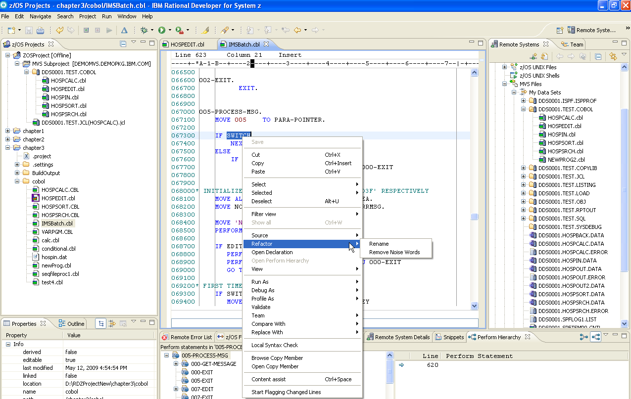
What is Rational Developer for System z ?
IBM’s Application Development Workbench for the 21st Century
RDz provides a workstation-based environment with advanced, graphical-tool-based access to z/OS data sets and z/OS resources.

Slide 47
What Can You Do with Rational Developer for System z ?
With RDz you can:
  Develop mainframe applications in:
    COBOL
    PL/I
    HLASM (high-level assembler language)
  Target code you write for:
    z/OS Batch
    z/OS online applications running CICS or IMS TM
    z/OS with access to: DB2, IMS (DL/I), QSAM, VSAM data structures
    Windows-based systems
    AIX-based COBOL systems
RDz enables:
  z/OS traditional mainframe coding and testing
  Integration with leading-edge z/OS development tools and features
  Template-based development
  Integration with modern languages and toolsets

Slide 48
Two Rational Developer Offerings for System z (RDz)
IBM Rational Developer for System z
with EGL
  Bundles RDz capability with Rational Business Developer (RBD)
  Best for creating System z applications with EGL web or Rich UI front-end applications (Web 2.0)
RDz with EGL
RDz
Edit, Compile, Debug
Web Services
PD Integration
RBD (*)
EGL, JSF, Rich UI
COBOL Gen,
etc
Eclipse
IBM Rational Developer for System z
with Java
  Bundles RDz capability with Rational Application Developer (RAD)
  Best for creating System z applications combined with Java Enterprise Edition
  front-end applications
RDz with Java
RDz
Edit, Compile, Debug
Web Services
PD Integration
RAD (**)
JEE, JSF, Web 2.0
J2C tools
etc
Eclipse
* RBD = Rational Business Developer
** RAD = Rational Application Developer

Slide 49
RDz Traditional Development Features and Facilities – Where Do You Develop?
z/OS application development can be accomplished using one of two work-flow models:
  Workstation-based offloaded development and unit test:
    Analyze, Edit, Compile, Unit test with integrated, graphical development tools and Integrated Development Environment (IDE)
    BMS and MFS map “painting” facilities
  Workstation-based remote z/OS Development and test:
    Edit, Compile, Unit Test, Integration/Systems Test, Resolve z/OS application ABENDs (defects) – with the same integrated, graphical tools and IDE
    Drag & Drop between mainframe and PC and between mainframe LPARs
    Applications tested on the host and debugged using z/OS datasets and databases
    Workstation-based, graphical tools for z/OS dataset management
    TSO command line, and ISPF (host) emulator sessions
    Integration with all major Source Control Management systems
    Graphical tools access to JES and job queues
    Access to Unix System Services
You can swap from Workstation-based to remote at any time. The next slide describes many of the development configurations and application resources supported by RDz.

Slide 50





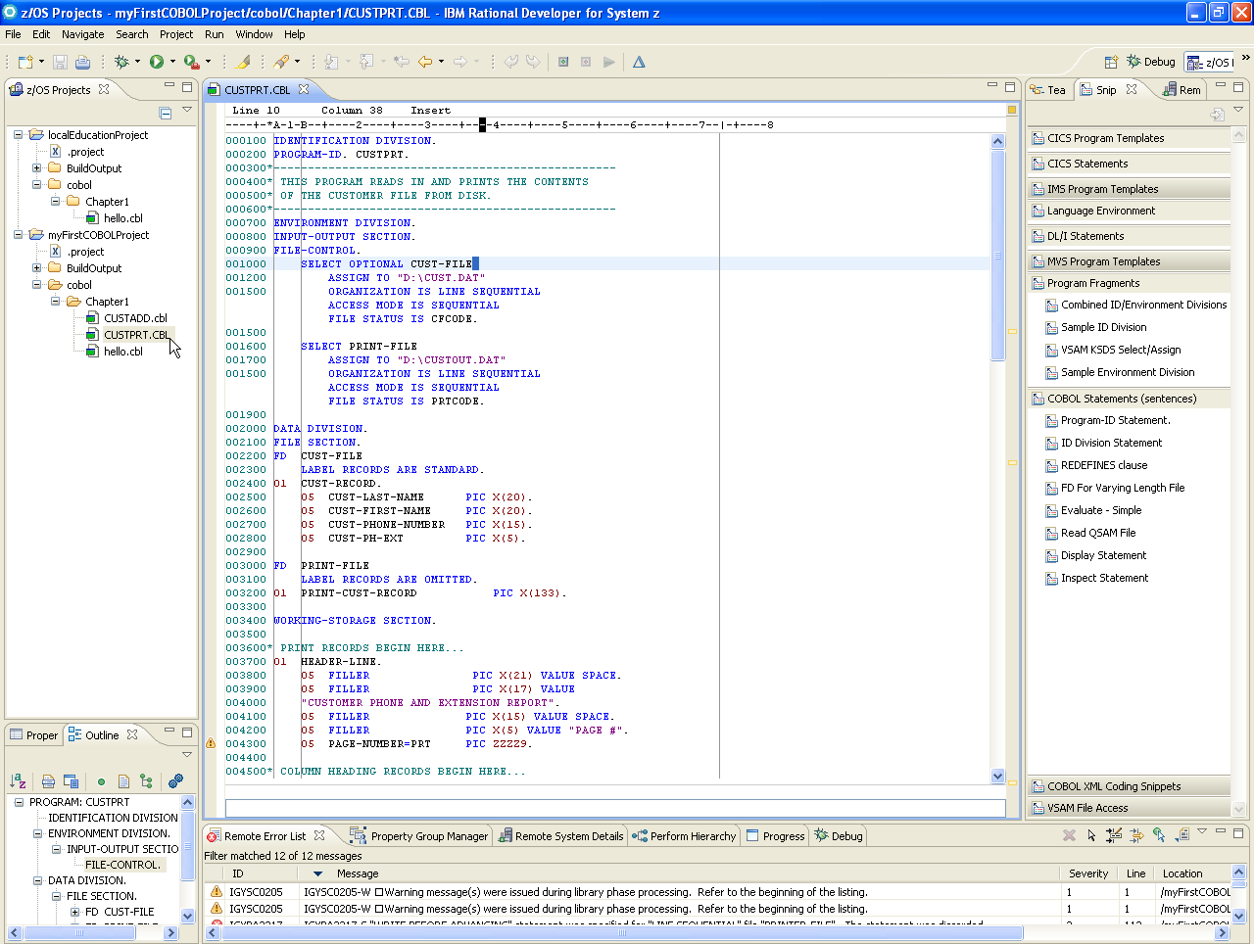

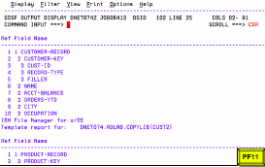
RDz Development Options – Local and Remote
Using RDz you can work:
Locally – on your PC
Remote – connected to z/OS, with
access to the resources
shown here ➔
CICS Screens
MFS Screens
Fault Analyzer
TSO/ISPF
Web
Job queues
and JES
Subsystem
z/OS Mainframe System
Source Control Management
COBOL
PL/I
Assembler
______ Remote Development and Test ______
PDS/PDSE
Datasets
RDz Workbench
DB2/Z
Data
QSAM
Datasets
Local Projects
Sequential Files & UDB
VSAM
Datasets
DL/I Database
Local Development and Test
File Manager
Notes:
Note that, if you’re not a mainframe developer, and all of those acronyms seem a bit daunting, not to worry. We will be covering them in the days ahead – and defining terms, concepts, features and programming constructs.

Slide 51
IBM Rational Developer for System z version 7.6 – Key Features
XML Services for the Enterprise
- SOA support for COBOL or PL/I using CICS or IMS
Bottom-up/Top-down or meet-in-the-middle COBOL/PLI to XML mapping support
meet-in-the-middle development scenario tooling wizards. for CICS, IMS, and batch applications
IBM Rational Developer
for System z
z/OS Application Development
Work with z/OS resources like COBOL,
PL/I , C, C++, JCL, etc.
Interact with the Job Entry Subsystem (JES) to submit jobs, monitor jobs, and review job output
Perform dataset management actions
Perform typical edit, compile, and debug tasks on remote z/OS resources from the workstation
z/OS Application Development
XML Services for the Enterprise
CICS Service Flow support
Supports CICS Service Flow Feature
Wizards to build service flows out of your existing COMMAREA WSDL and Terminal based CICS applications.
DB2 Stored Procedure for COBOL and PL/I
Create DB2 stored procedures on z/OS in either COBOL or PL/I
Build and catalog support for the DB2 stored procedure
Debug z/OS based stored procedures from workstation
CICS Service Flow support
CICS BMS/IMS MFS Map Support
CICS BMS/ IMS MFS Map Support
Visually create and modify BMS Map sets or IMS/MFS
Generates JCL
Work with local or remote maps
DB2 Stored Proc for COBOL - PL/I
z/OS Tooling Integration
Read/Write/Update VSAM datasets via integration with IBM File Manager
Access IBM Fault analyzer reports for analyzing ABENDS and associating back to source code
DB2 App Generator wizard
z/OS Tooling Integration
DB2 App Generator wizard
Generate WSDL, JCL and CICS COBOL program to access DB2
Generate CRUD programs code from existing DB2 table, which can also be integrated into web service applications
VSAM App Generator wizard
VSAM App Generator wizard
Generate JCL , BATCH or CICS COBOL program skeletons to access VSAM/QSAM
UML to COBOL Transformation(*)
UML to COBOL Transformation(*)
Provide UML assets in order to represent COBOL in UML (Models, Profiles, Patterns)
UML transformations generate models more specific to COBOL target
Final transformation generates COBOL source
(*) Requires Rational Software Architect (RSA)
Rational Application Developer or Rational Business Developer
Core functions
Other functions

Slide 52
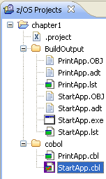
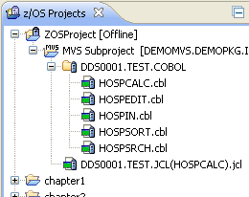
More About RDz's Local and Remote Projects
In RDz a project is a collection of related resources (source files and executables) that are organized in a hierarchical folder-set – of your design
  If you’re a mainframe developer, think of a folder as similar to a TSO library (PDS/PDSE) and the individual files in a project folder as members in the PDS
In RDz your projects can be organized (and stored) locally – on your PC. These are called z/OS Projects ➔
  And using RDz you can edit, compile (locally), run and debug
RDz also supports “Remote Projects – Known as MVS Subprojects”
Remote projects are z/OS files, accessed from RDz via a remote explorer and presented graphically like local projects
RDz allows you to edit, compile/link (on the mainframe), run and debug on the mainframe – remotely – as well as allocate mainframe datasets, copy and move files, sync versions, upload and download files, move files between LPARs, etc.
This allows you to get the benefits of RDz’s exceptional tools and technology, without having to offload (transform, download and convert) source and data files
As shown, "Remote Projects" can be Offline - Only active on your workstation or Online and synchronized with z/OS. By working offline you save additional z/OS resources without sacrificing any development functionality.

Slide 53
Why RDz?
Provides a common IDE for:
  Traditional mainframe development
  Leading-edge mainframe development
  Cross-platform development for:
    COBOL, PL/I and assembler programmers
    Java developers
    Web services projects
    Web 1.0 and Web 2.0 developers
Provides an integrated set of tools that support end-to-end application development – from analysis, to editing, unit test, integration test and deployment of applications
Offers easy-to-use graphical tool functionality
  Ask yourself – when was the last time you opted for DOS commands on your PC as opposed to dragging and dropping with Windows functionality?
Allows remote interactive testing, debugging, and deployment of CICS and IMS/TM applications, and batch debugging of COBOL, PL/I, and assembler applications
Use integrated graphical tools to do mainframe work:
  Submit and monitor jobs
  Issue TSO commands, CLISTs, and REXX EXECs
  Allocate files
  Edit mainframe test data:
    DB2
    QSAM files
    VSAM files (with File Manager)
Web 1.0
Web 2.0

Slide 54
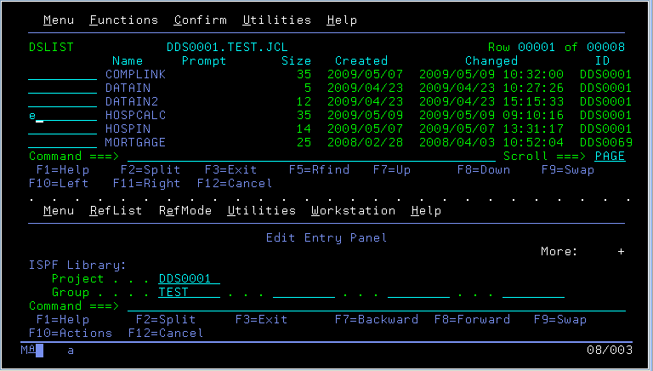
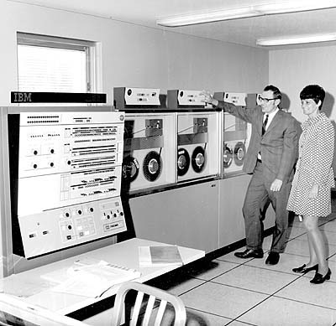
Why RDz?
Same basic functionality over the past 30 years
With RDz…………
See more
Do more
Work much more productively
Save time and money

Slide 55
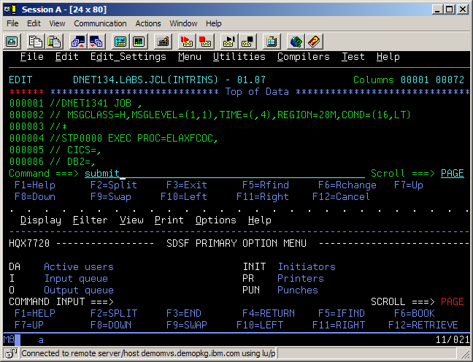
Traditional Mainframe Development Using TSO/ISPF
Multiple, separate tools, and a development platform limited by the technologies created during the Gerald Ford administration (or the year that Barbara Streisand's "The Way we Were" was the #1 Billboard hit)
submit compile job
swap to SDSF
select job
edit JCL
find error msg
find code line (remember error)
exit source
change code
swap to edit session
find code line
edit source
exit JCL

Slide 56
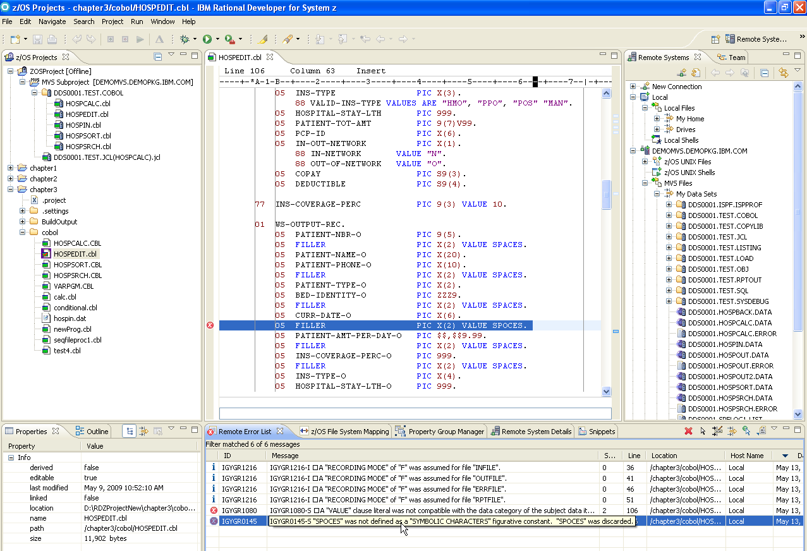
RDz Integrated Tools – Edit/Check/Compile/Debug/Run
Edit Source
Syntax Check
Double-click Syntax Error
(positions cursor on error line)
Notes:
With the z/OS Application Development support provided in RDz, the developer now makes changes in the editor, does a syntax check, double-clicks on any error and is positioned at the source statement in error. The developer can make the appropriate changes, save and syntax check, submit the JCL to compile the program, and check the results, all with a few clicks of a mouse. The development process has been simplified.

Slide 57
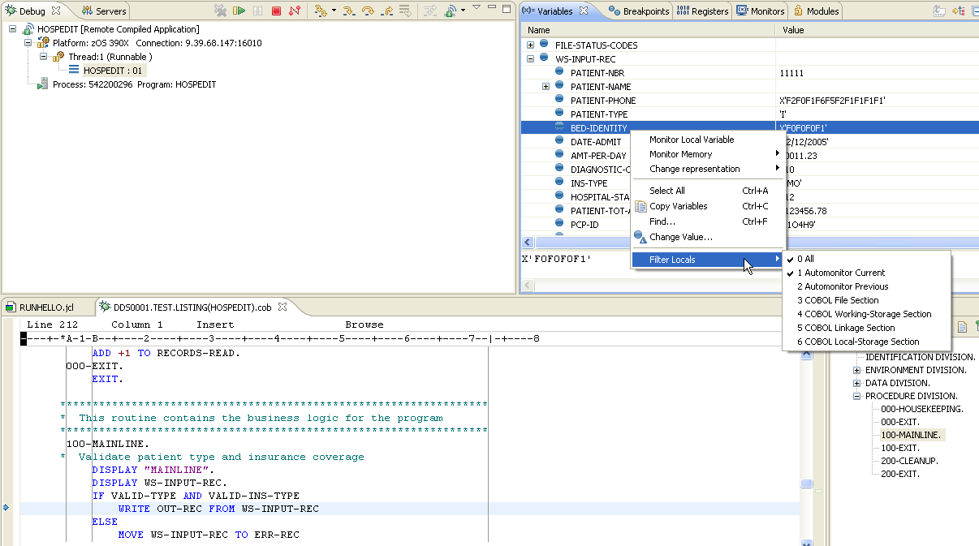
RDz Integrated Tools – Remote Debug
Run application on the host:
  From CICS, IMS TM, PROCs or run-stream JCL accessing z/OS-based testing datasets and databases
Debug program using RDz integrated, graphical tools

Slide 58
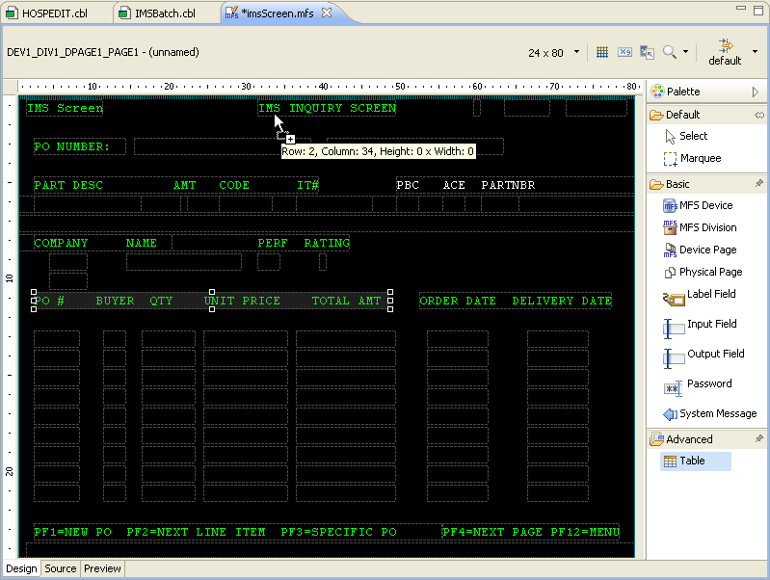
Integrated CICS/BMS – IMS TM/MFS Map Editor
For both CICS/BMS and IMS/MFS:
  Graphical editing
  Source-mode editing
  Preview
    Run-time simulation
Notes:
The Basic Mapping Services (BMS) map editor provides a design canvas that lets you quickly create and edit CICS BMS maps, and then lets you generate the JCL to compile the maps.

Slide 59
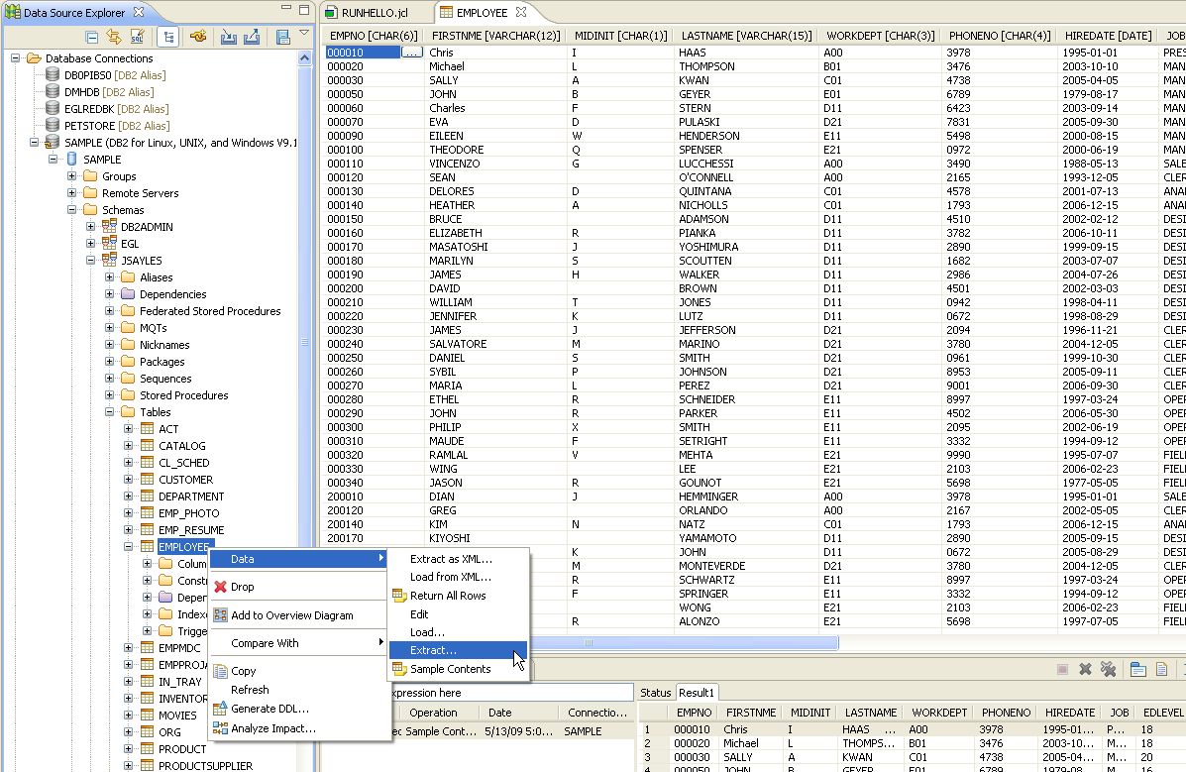
Integrated DB2 Relational DBMS Table Editor
Full-screen test data editing facility
SQL statement: Editor, Query build facility, Test
Create, deploy and test DB2 Stored Procedures

Slide 60
Leading-Edge COBOL Development Features
Integration with a bevy of leading-edge z/OS development tools and features:
  Web Service – create and consume
  DB2 Stored Procedures – create, test, deploy
  XML-COBOL – development and testing
  CICS and IMS TM SOA Aggregation – Service Flow Modeler
  IBM Problem Determination Tools – Fault Analyzer, Debug Tool, File Manager
  QSAM/VSAM/DL/I database/DB2 table/test-data browse and edit
Template-based development:
  Program-level Coding Patterns
  Application-level Frameworks
Integration with other modern languages and toolsets:
  Java applications
  Web 1.0 applications
  Web 2.0 applications

Slide 61
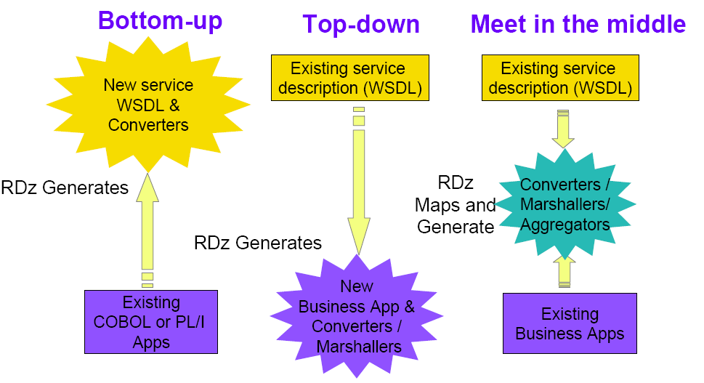
CICS and IMS TM COBOL and PL/I Web services
Wizards for enabling Enterprise SOA assets from CICS COMMAREA, and IMS IO-PCB masks.
RDz
Maps and
Generates
COMMAREA
IO-PCB
COBOL
PL/I module

Slide 62
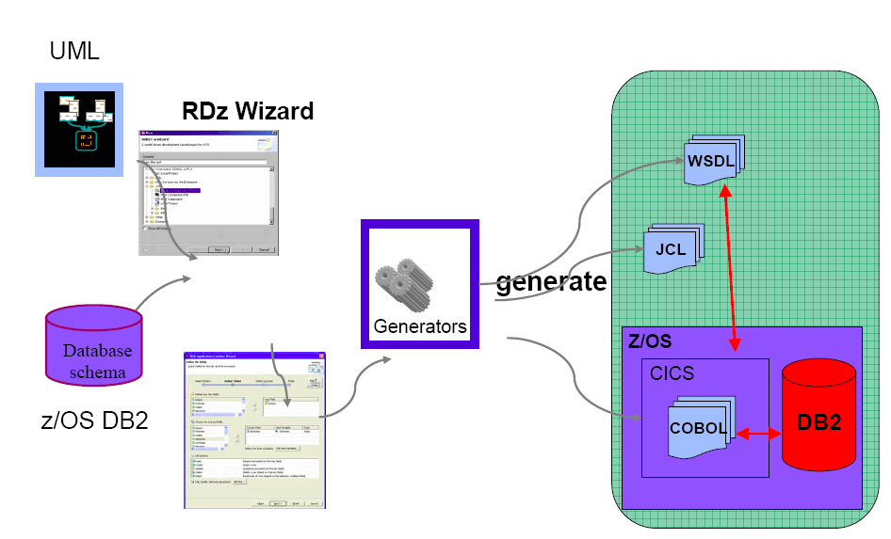
VSAM or DB2 Application Generator
Wizards for creating CRUD (Create/Read/Update/Delete) COBOL application frameworks – for both VSAM and DB2 data sources
UML Model
Data
Base
VSAM
Files

Slide 63
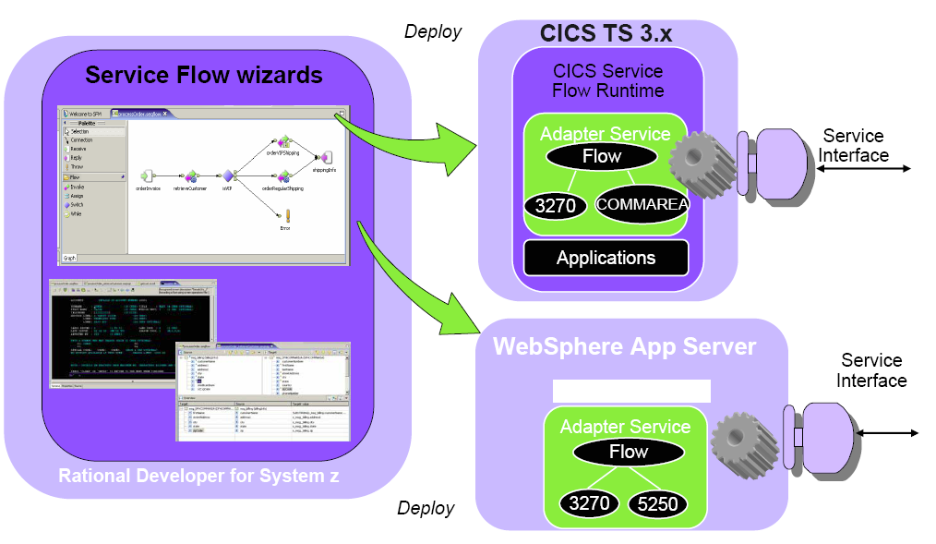
Service Flow Modeler
Service Flow Modeler is a feature that allows you to aggregate existing CICS applications into composed business services, which may be integrated into a SOA environment
…or later

Slide 64

COBOL and PL/I Stored Procedures
Create, Explain (analyze performance), Test and Deploy Stored Procedures

Slide 65


Enterprise Generation Language (EGL) COBOL Generation
High-level programming language for developing leading-edge business applications
  Web 1.0 – J2EE/Java
  Web 2.0 – JavaScript/AJAX
Independent of implementation
  Hides technology complexities
  Presentation and persistence layer API fully generated
Enables Rapid Application Development
Simplifies development of Services
Run-time code generated for appropriate platform
  Java and JavaScript for Windows, Linux, System I, etc.
  COBOL for System z and/or System i
Development and Generating Tools included with Rational Business Developer (RBD) – if using RDz with EGL
Migration path for Cross System Product (CSP), Visual Age Generator, and Informix 4GL customers
iPhone – Web 2.0 application
WebSphere Application
Server
IBM z/10 series
COBOL
CICS
Application
COBOL Wrapper
Generated by RDz
WSDL
DB2
Database

Slide 66
RDz and COBOL
In this class we will focus initially and primarily on local COBOL development using RDz installed on your personal computer:
  Teaching as much of the language as possible using RDz local projects.
  This includes:
    The foundation COBOL language and Language Environment (LE) functionality
    SQL and accessing DB2 (relational) data
    CICS and running local online applications using IBM’s TX-Series product
  Then, moving up to the mainframe, for work that is best learned on the deployment platform you’ll be running your labs on:
    Mainframe z/OS
    Using JCL, running and working with jobs and job queues
    And accessing IMS TM – DL/I and online screens using MFS
      Note – if you're interested in IMS TM, here is a current best-in-class manuscript:
        http://www.ibmpressbooks.com/articles/article.asp?p=377307&seqNum=2
But, let’s talk for a minute about local …versus remote RDz projects before discussing working on the mainframe and other things you can do with RDz

Slide 67
RDz and Advanced COBOL Development Techniques and Technologies
There are a number of optional RDz topics you can learn about
Some will be presented at the end of this course; others are available through additional IBM education venues:
  The Enterprise Modernization Sandbox
    http://www.ibm.com/developerworks/downloads/emsandbox/systemz/assets/
  White papers published in DeveloperWorks
    http://www.ibm.com/developerworks/
  Classes from Rational Education
    http://www-01.ibm.com/software/rational/education/
Advanced COBOL development techniques and technologies, they include:
  COBOL and Service Oriented Architecture (SOA)
    Creating and consuming Web Service Definition Language (WSDL) files as interfaces into existing CICS and IMS COBOL mainframe functionality
  COBOL and DB2 Stored Procedure creation
    Creating, deploying and testing DB2 Stored Procedures using a wizard-driven approach
  COBOL and XML data access and manipulation
    Reading (parsing) and writing XML files in COBOL
  Template-ized COBOL database and file application generation
    Using UML and wizards to build COBOL applications declaratively

Slide 68
RDz – Additional Independent Study
IBM has set up a large number of sites with quality learning content surrounding Rational Developer for System z:
RDz IBM product web page:
  http://www-01.ibm.com/software/awdtools/rdz/
RDz productivity study:
  http://publib.boulder.ibm.com/infocenter/ieduasst/rtnv1r0/index.jsp
RDz recorded demos (click on Rational Developer for z)
  http://publib.boulder.ibm.com/infocenter/ieduasst/rtnv1r0/index.jsp
RDz manuals and redbooks:
  http://www-01.ibm.com/software/awdtools/rdz/library/index.html
About System z mainframes:
  http://publib.boulder.ibm.com/infocenter/zos/basics/index.jsp?topic=/com.ibm.zos.zconcepts/zconcepts_166.htm
  http://w3.democentral.ibm.com/wps/portal/systemz
  http://www.ibmsystemsmag.com/mainframe/index.aspx
  http://www-03.ibm.com/systems/z/destinationz/

Slide 69
About RDz Development – Summary
After having completed this topic, you should now be able to:
  Describe the major areas of RDz enablement
  Define the difference between local and remote RDz projects
  List at least two of the leading-edge COBOL features/functions for which RDz provides tooling

